Slide 1
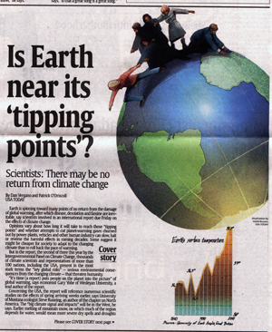
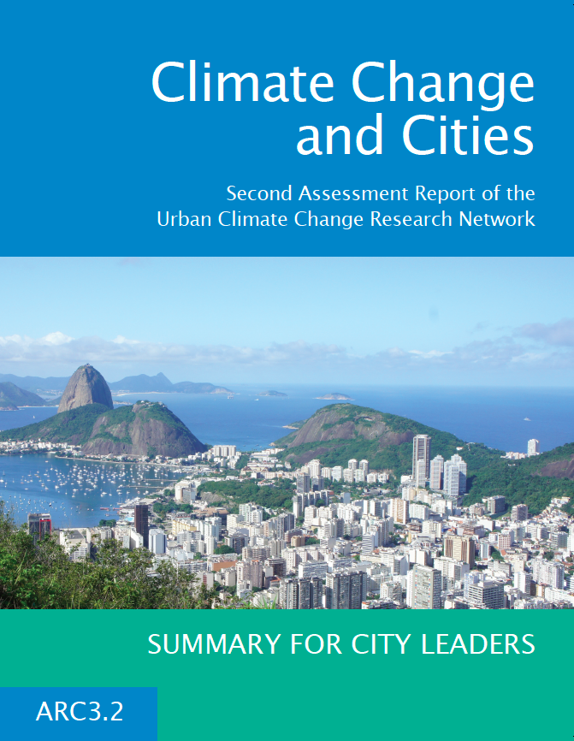
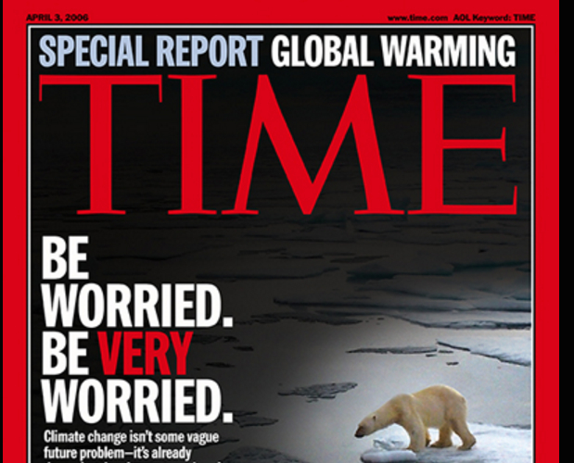
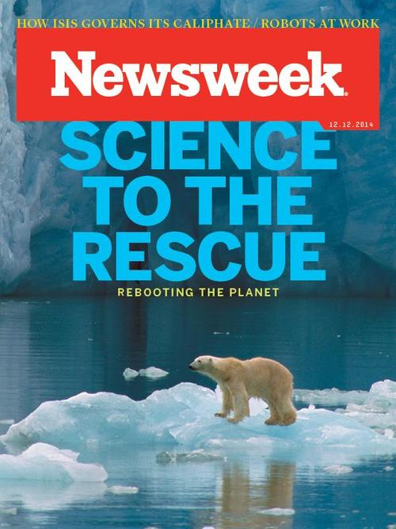
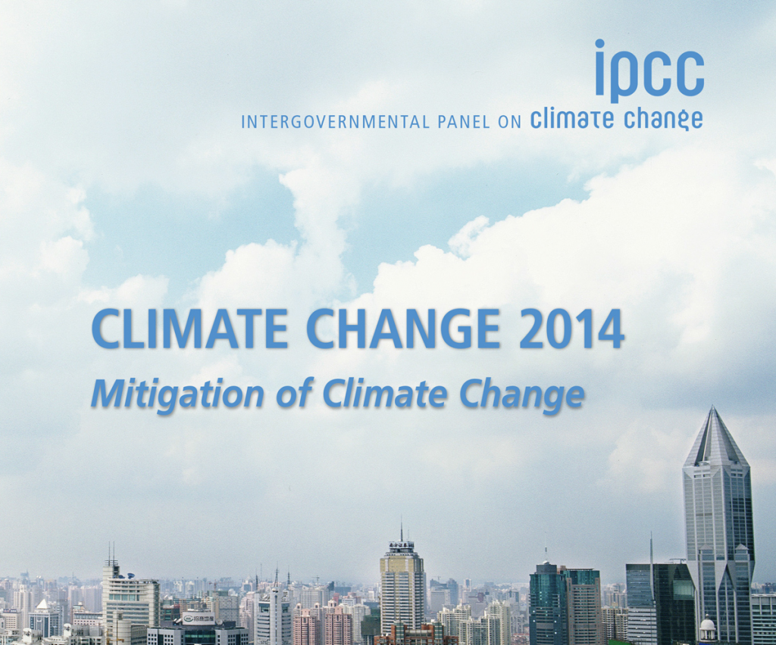
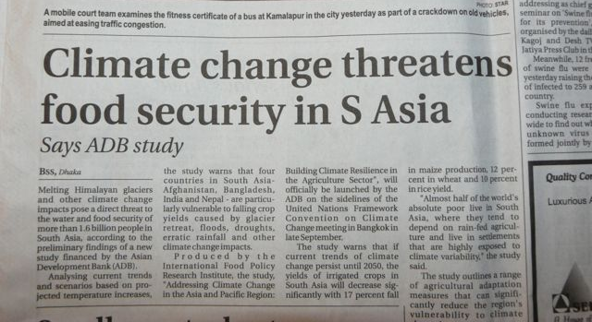
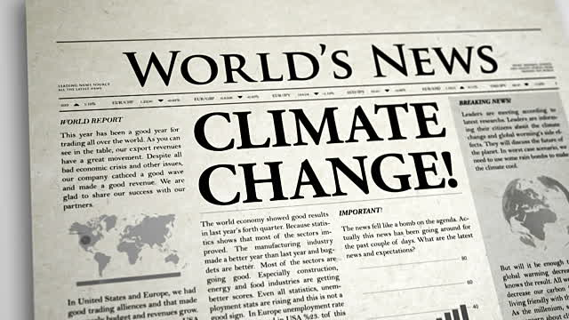
How do we know?
Notes:
Developed by Robert Logan
Kellogg Biological Station
Hickory Corners, MI
December 2016

Slide 2
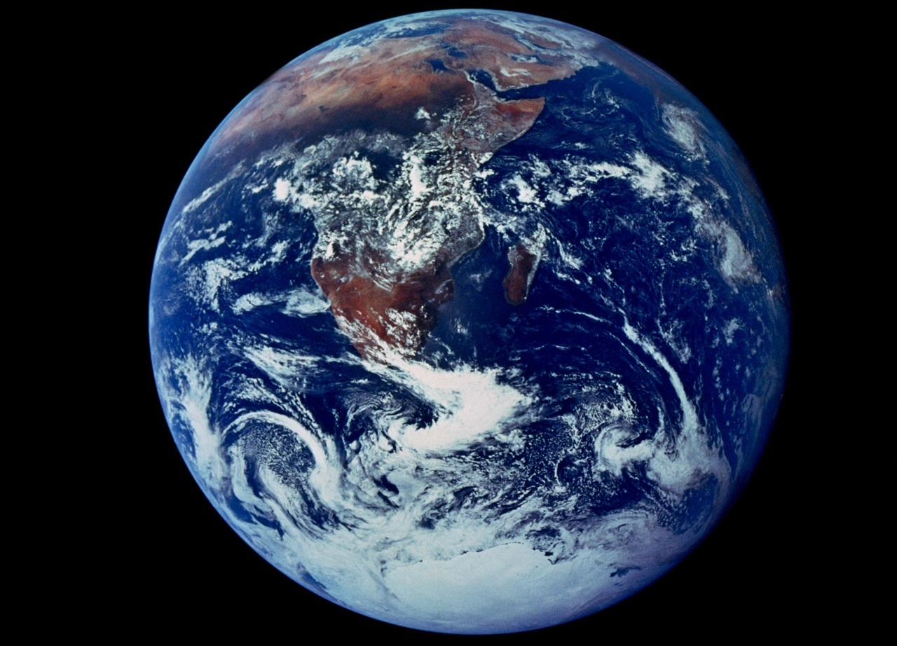
Predict Earth’s Future: Building your own climate model

Slide 3
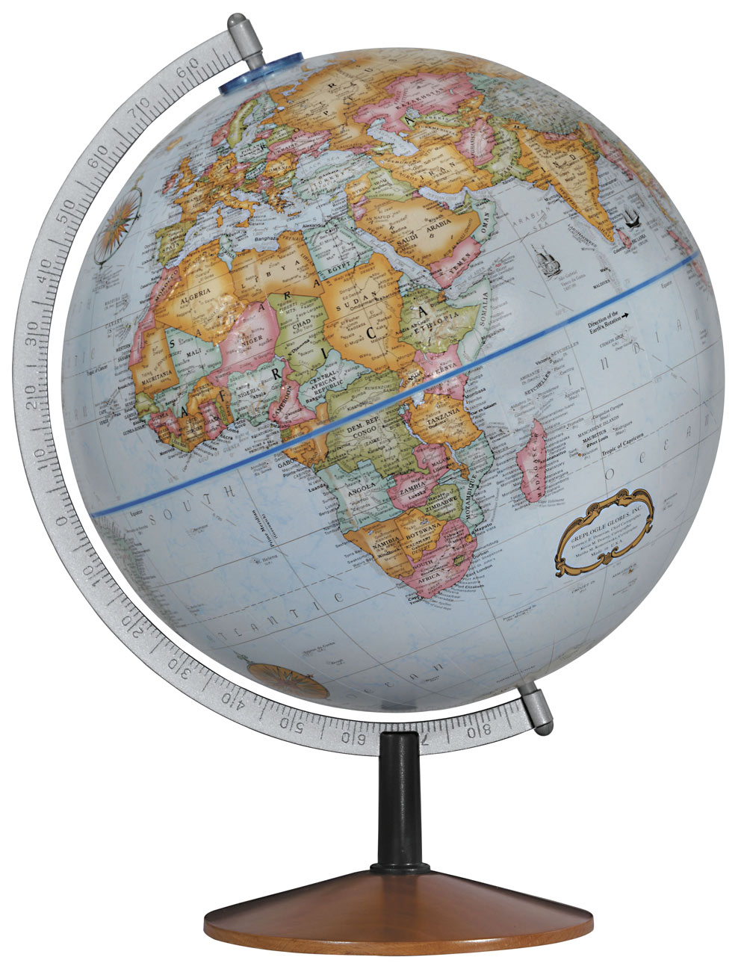
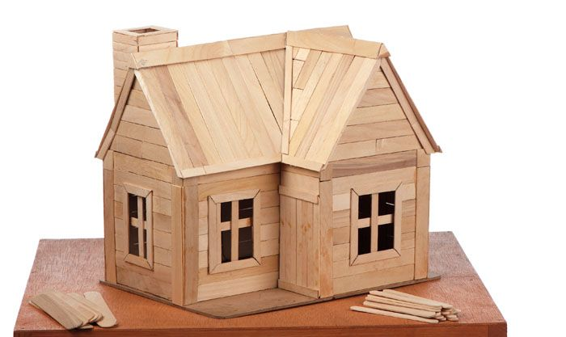
What is a model?
A simplified representation of something in the real world that we used to better understand the real world.

Slide 4
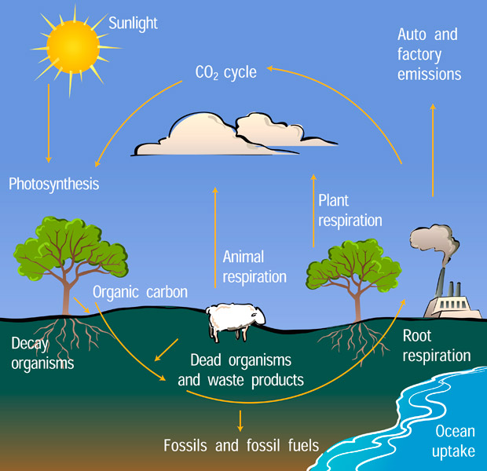
Scientific Models
CO₂ & photosynthesis
?
?
Plant growth
?
CO₂ Concentration
Notes:
http://scied.ucar.edu/sites/default/files/images/large_image_for_image_content/carbon_cycle_diagram_ucar_620x600.jpg

Slide 5
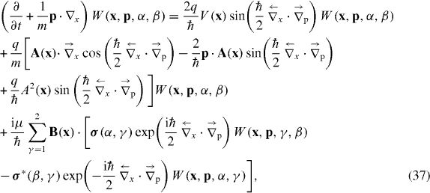
Scientific Models
Use equations to describe relationships from the real world and make predictions
Notes:
http://www.messagetoeagle.com/wp-content/uploads/2015/09/mathemacticalcrystalball.jpg
https://s-media-cache-ak0.pinimg.com/736x/75/b4/22/75b422fe66794711dd6c980cb0b6ad92.jpg

Slide 6
Your goal: Develop a climate model to predict what the global temperature will be in 2050.
Decide which data to include.
Build your model and make a prediction.
Test how different policies will change your prediction.
Data
Global Temperature
Catastrophic Volcanic Eruptions
Sunspot Number
Aerosol Optical Depth
CO₂ Concentration
Cattle in USA
http://tinyurl.com/BuildClimateModel-1

Slide 7
Intergovernmental Panel on Climate Change Assessment Report #5 Representative Concentration Pathway 4.5 (moderate mitigation)
~10.6 °C
9.22 °C
Notes:
Kirtman, B., S.B. Power, J.A. Adedoyin, G.J. Boer, R. Bojariu, I. Camilloni, F.J. Doblas-Reyes, A.M. Fiore, M. Kimoto, G.A. Meehl, M. Prather, A. Sarr, C. Schär, R. Sutton, G.J. van Oldenborgh, G. Vecchi and H.J. Wang, 2013: Near-term Climate Change: Projections and Predictability. In: Climate Change 2013: The Physical Science Basis. Contribution of Working Group I to the Fifth Assessment Report of the Intergovernmental Panel on Climate Change [Stocker, T.F., D. Qin, G.-K. Plattner, M. Tignor, S.K. Allen, J. Boschung, A. Nauels, Y. Xia, V. Bex and P.M. Midgley (eds.)]. Cambridge University Press, Cambridge, United Kingdom and New York, NY, USA.

