Slide 1
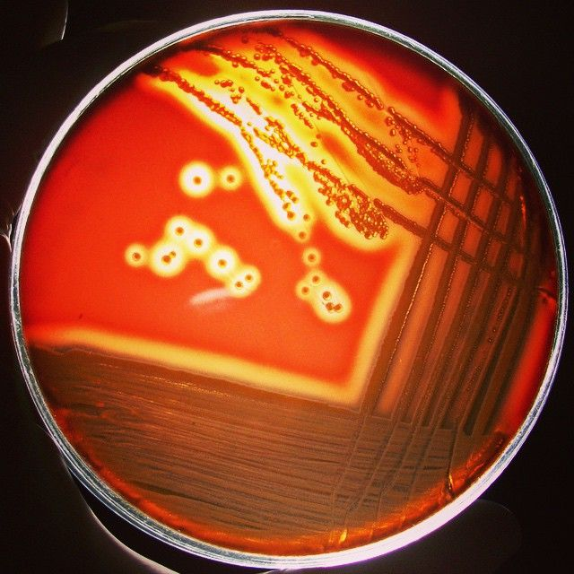

Microbial Connections: the rise of antibiotic resistance
Heather Kittredge
GK12 Fall Workshop
11/16/2015

Slide 2
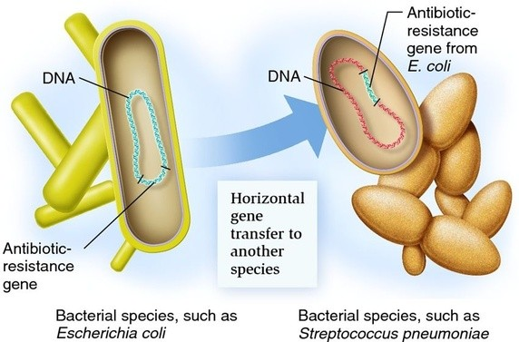
My Research
Horizontal Gene Transfer -
Transformation
Notes:
that encode a beneficial microbial process are often under positive selection but also

Slide 3
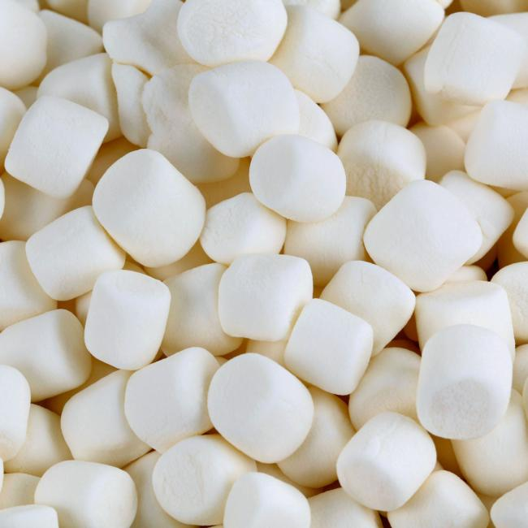

Talk Outline
Introduction to antibiotic resistance
The antibiotic resistance crisis
Next steps

Slide 4
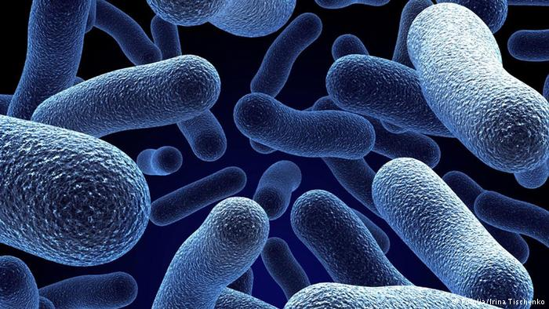
Bacterial Warfare
Bacteria must compete with each other to survive.
One bacterial defense is to secrete toxins!
Antibiotics are these same toxins produced in mass quantities to kill bacteria that harm mammalian cells.

Slide 5
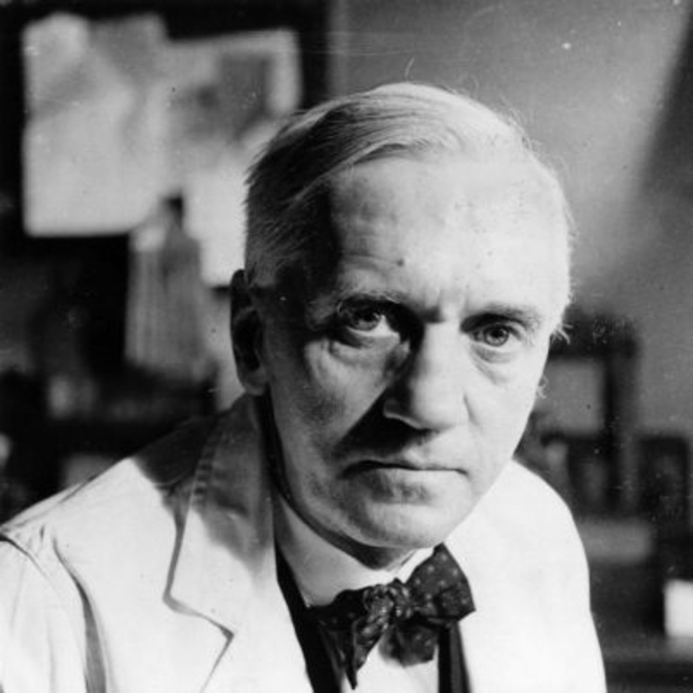
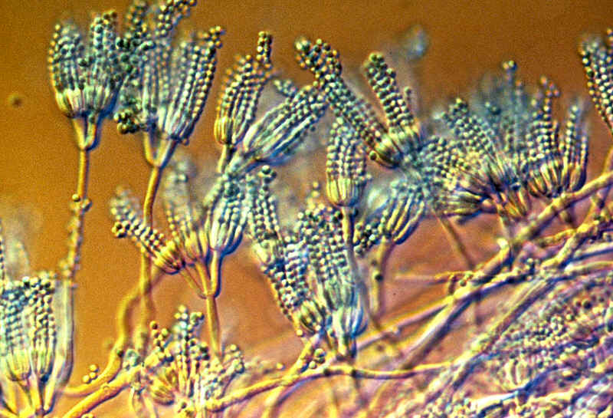
The First Antibiotic
Penicillium
The first antibiotic was discovered by Alexander Fleming in 1928 when he noticed that the fungus penicillium killed disease causing bacteria.

Slide 6
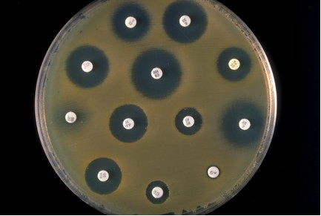
Antibiotics target bacteria
Zone of Inhibition

Slide 7
Antibiotic Resistance Facts
Antibiotic resistance is the process by which bacteria become resistant to antibiotics.
Humans can have allergic reactions to antibiotics, but we do not become resistant to antibiotics.

Slide 8
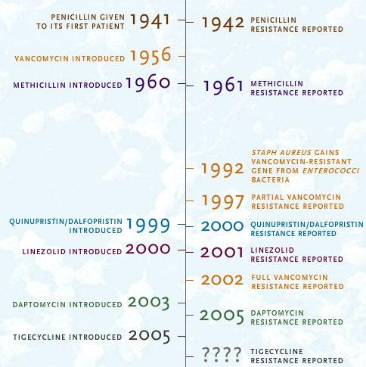

Slide 9
Antibiotic Classes
Penicillins
penicillin
amoxicillin
Cephalosporins
cephalexin(Keflex)
Sulfonamides
co-trimoxazole (Bactrim)
Fluoroquinolones
ciprofolxacin (Cipro)
levofloxacin (Levaquin)
ofloxacin (Floxin)
Tetracyclines
Tetracycline(Sumycin)
doxycycline (Vibramycin)
Aminoglycosides
gentamicin (Garamycin)
kanamycin
tobramycin(Tobrex)
Macrolides
erythromycin (E-Mycin)
azithromycin (Zithromax)
Prevents bacteria from making cell walls
Inhibits
Folate synthesis
Inhibits DNA replication
Inhibits protein synthesis
Notes:
Mutations in target site of enzymes

Slide 10
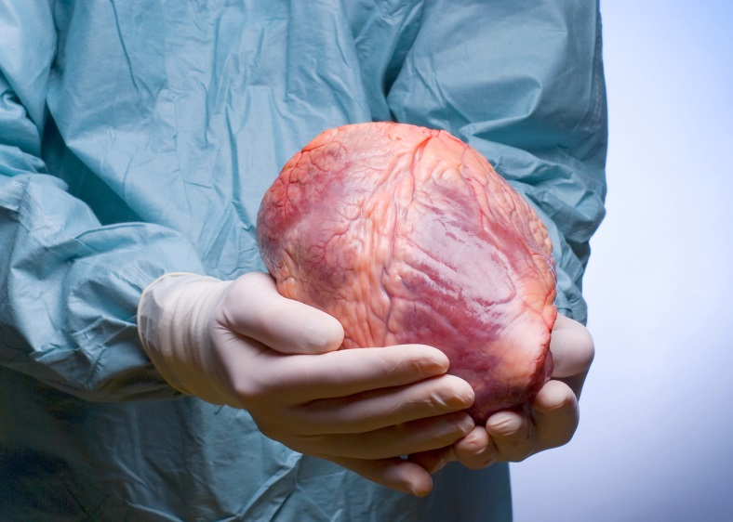
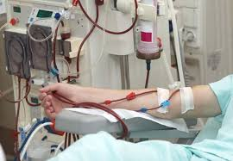
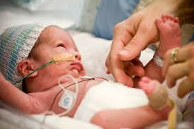

Antibiotic Usage
Transplants
Dialysis
Suppressed Immune Systems
Joint Replacements

Slide 11


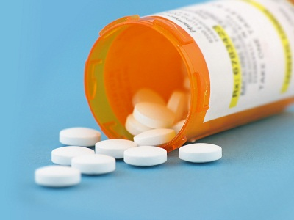
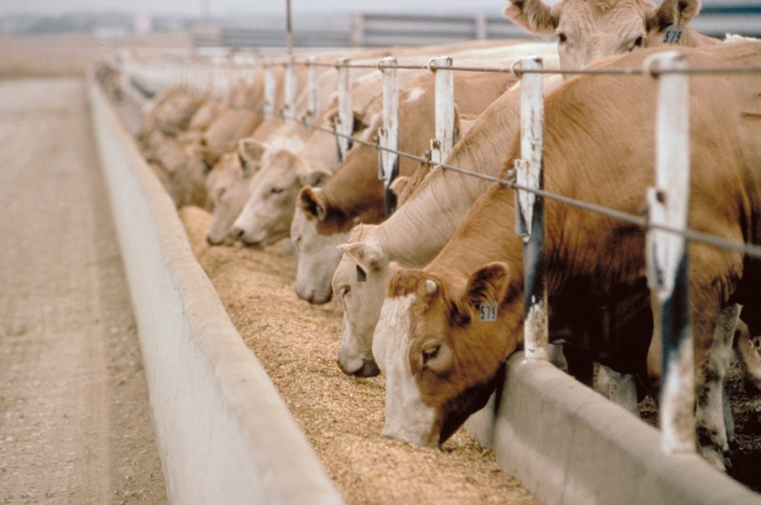
Antibiotic Overuse
Overprescribing
Continuous use in livestock feed
Humans = 30% antibiotic use
Animals = 70%
https://amr-review.org/file/327

Slide 12

How does antibiotic resistance arise?
Dose Two of Antibiotics
Dose One of Antibiotics

Slide 13

Speed of antibiotic resistance

Slide 14
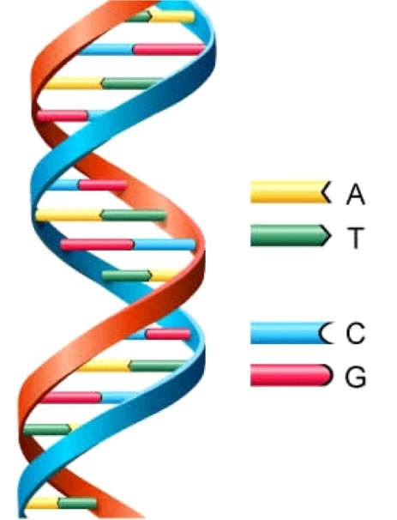
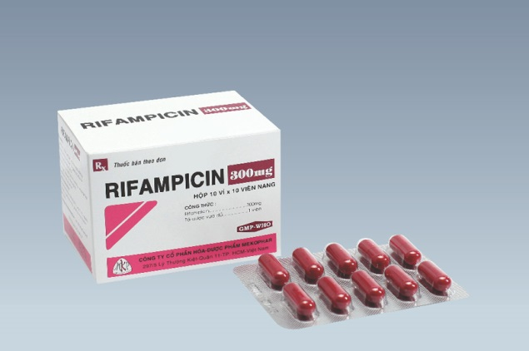
Resistance is an evolutionary process
Mechanisms of Evolutionary Change:
Mutation
Natural Selection
Gene Flow
Genetic Drift
Destroys RNA polymerase
A single base pair mutation in the gene rpoB confers resistance to rifampicin.

Slide 15
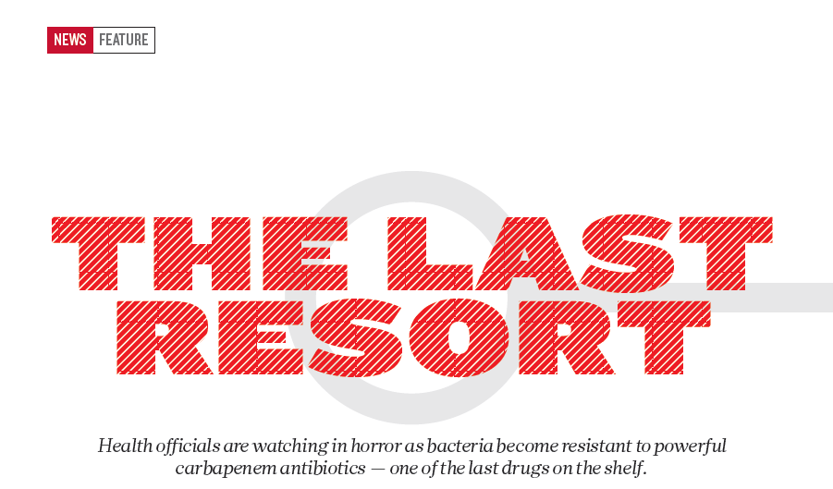

Slide 16
Antibiotic resistance crisis
An increase in resistant organisms
+
A limited number of new antimicrobial drugs
=
a problematic scenario
“The pharmaceutical industry has largely turned away from antibiotic research due to the low likelihood of getting a return on investment. Any new class of antibiotics would need to be used sparingly to conserve their effectiveness, meaning sales would be slow.” - WSJ

Slide 17
Post-antibiotic era
Currently:
80% of gonorrhoeal infections are now resistant to antibiotics.
440,000 new cases of drug-resistant tuberculosis annually.
In the future:
- Strep throat to a scraped knee could kill you.
- A simple hip replacement would result in 1 and 6 deaths.
- The cost to treat drug-resistant cases is estimated to be at least double.
“Antibiotic resistance should be added to the list of national emergencies”.
Sally Davies (Britain’s Chief Medical Officer)

Slide 18



The Davos Declaration
“International pharmaceutical, diagnostics and biotechnology companies, as well as key industry bodies, have come together to work in parallel in taking comprehensive action against drug-resistant infections “.
1. Reducing the development of drug resistance.
2. Increasing investment in R&D that meets global public health needs.
3. Improve access to high-quality antibiotics for all.
Notes:
As of April 1st, 2016, a total of 98 companies and 11 industry associations in 21 countries have signed the Declaration.

Slide 19
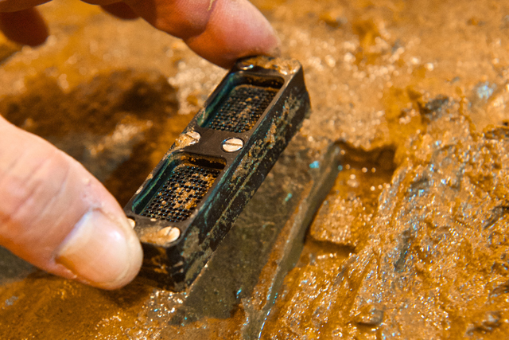
Discovering Antibiotics in New Ways
Teixobactin:
A new class of antibiotics
iChip
In the Nature study, teixobactin was shown to kill Staphylococcus aureus and Mycobacterium tuberculosis without the bacteria developing a resistance to the antibiotic.
Binds to lipids that build the cell wall.
Notes:
We were previously limited by our ability to isolate bacteria on media in the lab (predicted to support only 1% microbial growth). By culturing in situ we increase our odds of developing new antibiotics (50% grow).
Eleftheria terrae
Kim Lewis at Northeastern

Slide 20
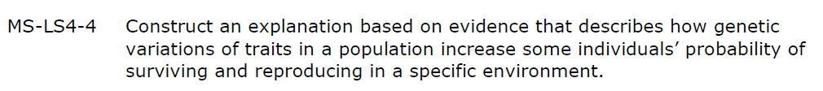
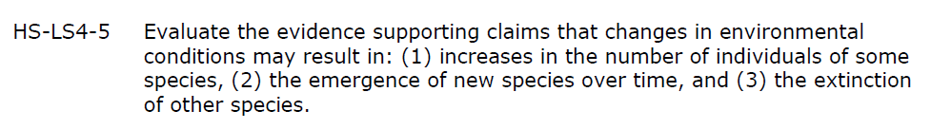
Michigan Science Standards
Natural Selection & Evolution

Slide 21

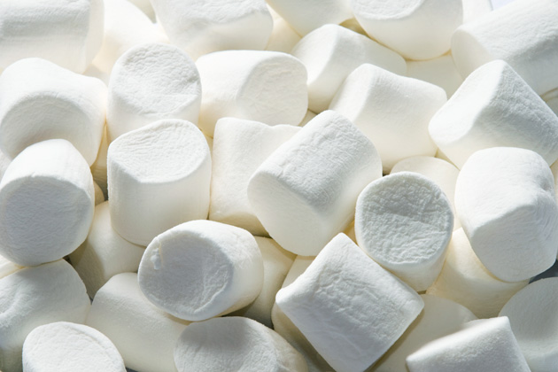

Modeling Antibiotic Resistance with Candy
Bacteria targeted by antibiotic
Antibiotic
Bacteria resistant to antibiotic

