Slide 1
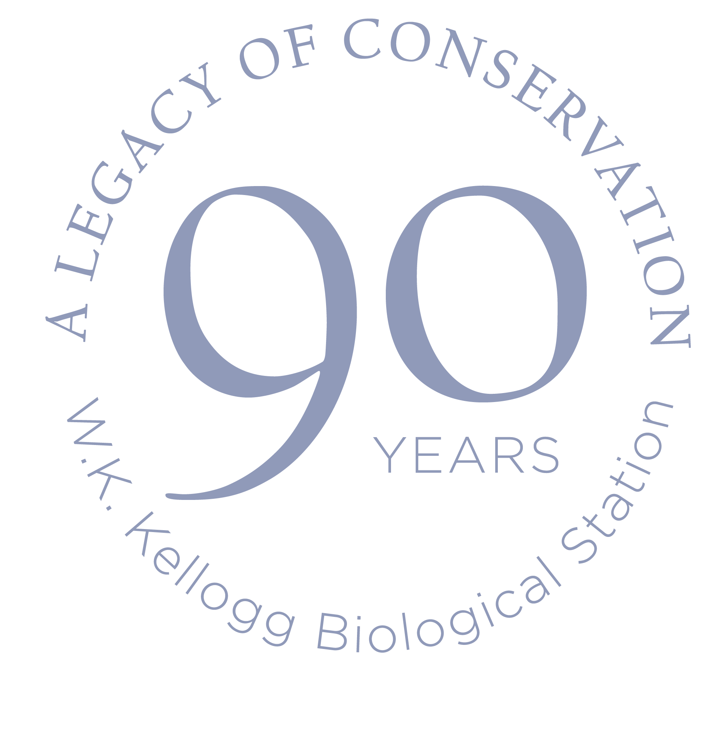
90 Years of the W.K. Kellogg Bird Sanctuary
Lisa Duke
Sanctuary Manager

Slide 2
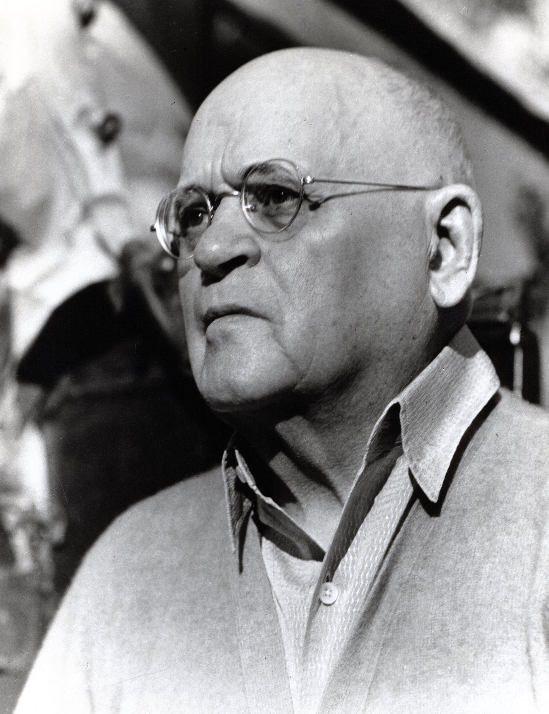
Will Keith Kellogg
Celebrate with us our legacy of conservation as we mark 90 years since W.K. Kellogg donated the lands that now make up KBS to Michigan State University. Our commitment to research, education and outreach stands on the foundation of W.K. Kellogg’s vision for cutting-edge science and learning.

Slide 3
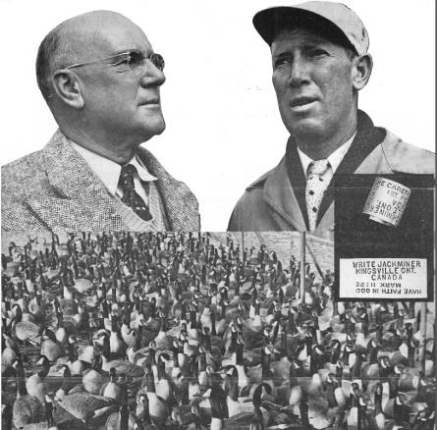
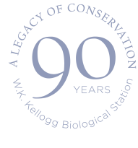
Why a bird sanctuary?
Circa 1900, W.K. Kellogg became intrigued over a lecture at the Battle Creek Sanitarium on birds and bird sanctuaries
Jack Miner in Kingsville, Ontario Canada. Had an established sanctuary and was having great success
Canada Goose was rare due to over hunting
Notes:
health resort based on the health principles advocated by the Seventh-day Adventist Church, most notably associated with John Harvey Kellogg
National conservation movement was beginning in earnest during this time in history. Few to no hunting restrictions in place and many wildlife and waterfowl habitats were destroyed by deforestation and dreaining of wetlands for agricultural and industrial use
Miner created pond on his property. Started a tame flock of CAGO. gets over 2,ooo Canada geese

Slide 4
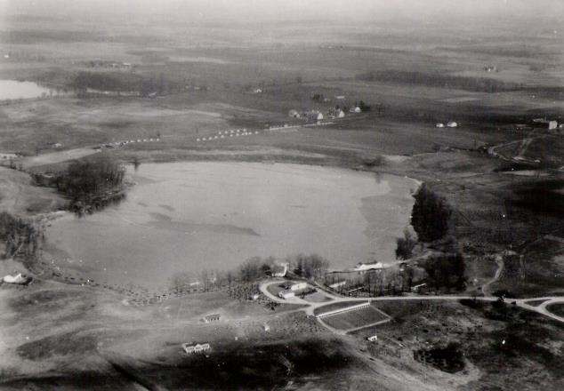
The start of it all!
Eagle Heights (W.K. Kellogg Manor House) completed in the fall of 1926
Created the Gull Lake Sanctuary Act of 1927
George Corsan recommended Wintergreen Lake for Kellogg’s Sanctuary
180 Acres were fenced in and the Sanctuary established!
Notes:
GULL LAKE SANCTUARY
Act 368 of 1927
AN ACT to create and protect a refuge district in a designated portion of the counties of Barry and
Kalamazoo, in the state of Michigan, to be known as “Gull Lake Sanctuary”, in which it shall be unlawful to
shoot, molest, catch, injure, destroy or kill any wild waterfowl, wild shore bird, wild game birds or any other
birds, or any wild animals except rabbits; and to provide penalties for the violation thereof.
History: 1927, Act 368, Imd. Eff. June 2, 1927;¾Am. 1931, Act 102, Eff. Sept. 18, 1931;¾Am. 1949, Act 120, Eff. Sept. 23, 1949

Slide 5
George Corsan 1927-1931
Diligent in decreasing predator population “varmints”
Planted many trees and shrubs on the property
Walnut, chestnut, and pecan
Over 4000 pine and spruce trees
Import and breeding of native and exotic game birds
Obtained Canada Geese from Miner to develop a decoy flock
Notes:
From Corsan’s point of view man had already destroyed any natural balance there might have been and no one could restore it.

Slide 6
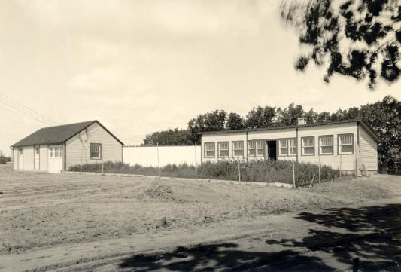
George Corsan 1927-1931
Kellogg hoped that his Sanctuary would serve as a practical training school for animal care and management
Sanctuary and Experimental Farm given to Michigan State College of Agriculture in 1928
Corsan replaced with Dr. Miles D. Pirnie

Slide 7
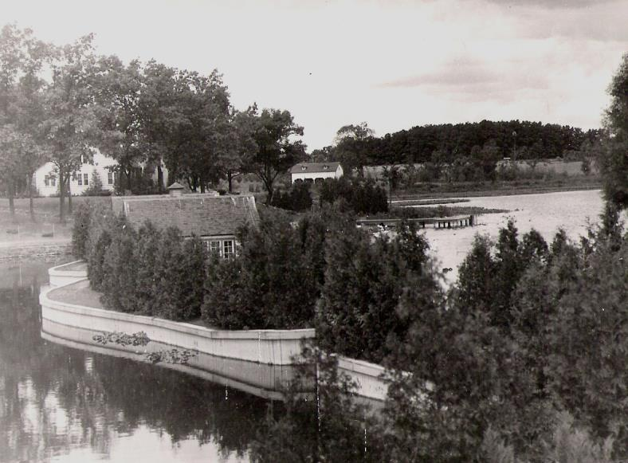

Slide 8
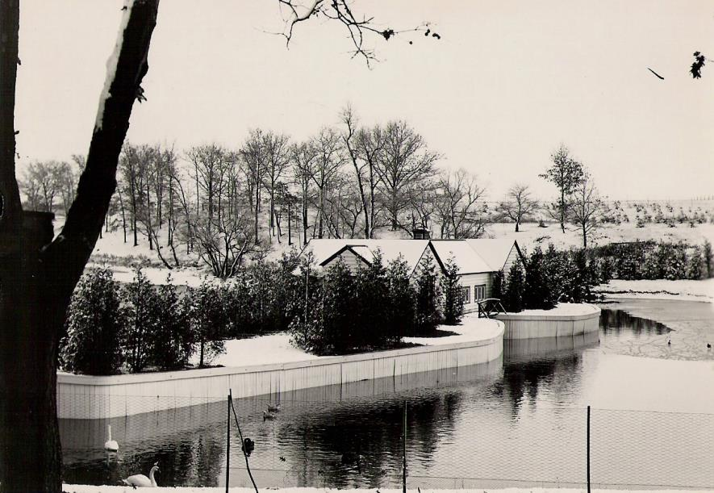

Slide 9
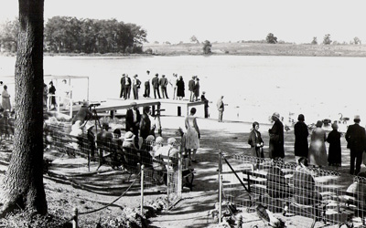

Slide 10
Dr. Miles D. Pirnie 1931 to 1948
Cornell graduate and waterfowl specialist – great choice to increase research and education at the Sanctuary
1931 started waterfowl leg banding program
Increased amount of research done at the Sanctuary with graduate students, who also created visitor programs.
Avid photographer and decoy carver

Slide 11
Canada Goose Conservation
Canada Geese prior to 1930 only seen in Spring and Fall migration
Decoy flock from Miner
Offspring became free flyers
Migrating wild Canada Geese were attracted to the 60 free flyers
Kellogg flock extends its nesting range

Slide 12
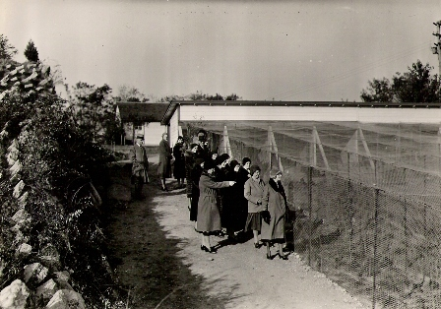
Education Programs
Pirnie traveled and presented programs using his photographs
Summer School of Biology
Helped the Sanctuary survive the Great Depression. Cut back on programs, but still open to visitors. Increased visiting hours to dusk. From 1933 to 41 over 100,000 visitors annually
Notes:
Summer school of biology from 1931 to world war II Field education in biology to MSC students studying to become biologists and teachers

Slide 13
Hard Times
Great Depression – reduction in staff. Used grad student labor to run Sanctuary
WWII – Educational programs cut. Facilities run down due to lack of resources.
Used German prisoners of war for labor force to work on Sanctuary grounds and buildings
Notes:
Pirnie left Sanctuary for a full professorial position at MSC

Slide 14
Dr. Arthur E. Staebler 1949-1954
At this time, the Sanctuary and Farm were grouped together as the Kellogg Station
Restocked empty pens from war years
Repaired facilities that had fallen into disarray
135,000 annual visitors in 1954

Slide 15
Dr. Arthur E. Staebler 1949-1954
Duck and Goose banding technique research expanded
W.K. Kellogg passed in 1951, and Manor House and grounds donated to MSC
Research on the fish communities in Wintergreen Lake and other wildlife at the Sanctuary by graduate students
Notes:
Staebler created a type of wing tag that is still in use today
Staebler left in 54 to work more on research

Slide 16
Roswell Van Deusen 1955-1985
MSC graduate
Hired as Biologist in Charge
Administered facility, worked on public outreach and expanding grad student research opportunities
Worked with local clubs, 4-H and schools

Slide 17
Roswell Van Deusen 1955-1985
Partnered with Soil Conservation Service to construct and maintain waterfowl nesting islands in farm ponds
Canada Goose population rose throughout the 1960’s
1961 Sanctuary administration shifted to W.K. Kellogg Biological Station – Resident faculty
Notes:
Sanctuary researcher found that all migratory geese flying over MI come from a single nesting ground W. Of James Bay in Canada and travel south in the fall and stop at the Sanctuary on their way to southern IL, IN OH KE and Tenn Valley

Slide 18
Roswell Van Deusen 1955-1985
Buildings that are seen today were constructed in the 1960’s with funds from the W.K. Kellogg Foundation

Slide 19
Roswell Van Deusen 1955-1985
Creation of new environmental education position – summer teacher training courses, summer day camp, adult education classes
Stressed backyard ecology in classes. Developed Sanctuary to serve as a demonstration area where the public could see the effects of plantings for wildlife

Slide 20
Wilbur C. “Joe” Johnson 1985-2007
Johnson did his graduate studies at the Sanctuary and joined the staff as a wildlife biologist and avian caretaker before becoming the Chief Biologist
Started the Trumpeter Swan reintroduction program
Worked with community and professional organizations

Slide 21
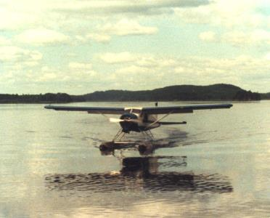
Trumpeter Swan Reintroduction
Notes:
Collected eggs from Alaska, Minto Flats. Would take two eggs from a nest of 4 and leave 2 behind. Collaboration with MIDNR. Brought back 92 eggs with live embryos

Slide 22
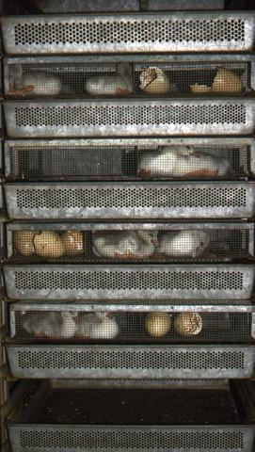
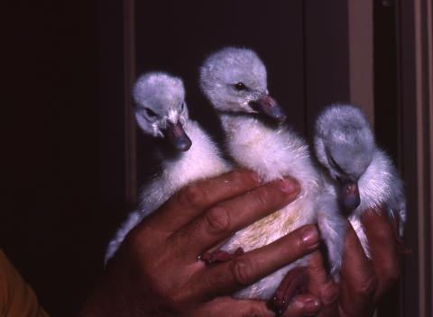
Trumpeter Swan Reintroduction
Notes:
Eggs were hatched and matured for two years. In 1992 the first trumpeter swans in mer than one hundred years were hatched in MI and in 1999 reached ints goal of having 200 free flying trumpeters in MI. A year ahead of their goal. Last census said that theyre were 700 pairs in MI.

Slide 23
Wilbur C. “Joe” Johnson 1985-2007
. In 1992 the first trumpeter swans in more than one hundred years were hatched in MI
In 1999 reached its goal of having 200 free flying trumpeters in MI.
Last census said that there were 700 pairs in MI.

Slide 24
Tracey Kast 2007-2009
New position of Environmental Education and Outreach Coordinator
Started the Field Ornithology Course in 2008 with Russ Schipper from Kalamazoo Audubon Society
Established Nest box monitoring by volunteers and other citizen science programs

Slide 25
Kara Haas 2009-2014
Created a Strategic Plan with community
Facility upgrades – New bridge, Interpretive Sign Project
Educational Programming expansion – Ag and Eco Student Activity Trail
Established new walking trails to over 3 miles of trails
Active research on the property and hosts MSU classes and interns

Slide 26
Lisa Duke 2015-?
Facility upgrades- Overlook Deck, fencing replacement, bird pen upgrades
Educational Programming expansion – Field Botany
Increased tour options with Add-on Programs
Native pollinator garden expansion

Slide 27
What’s next?
Capital Campaign
Educational Programs to share more of the science that is occurring at KBS

Slide 28
Questions?

