Slide 1
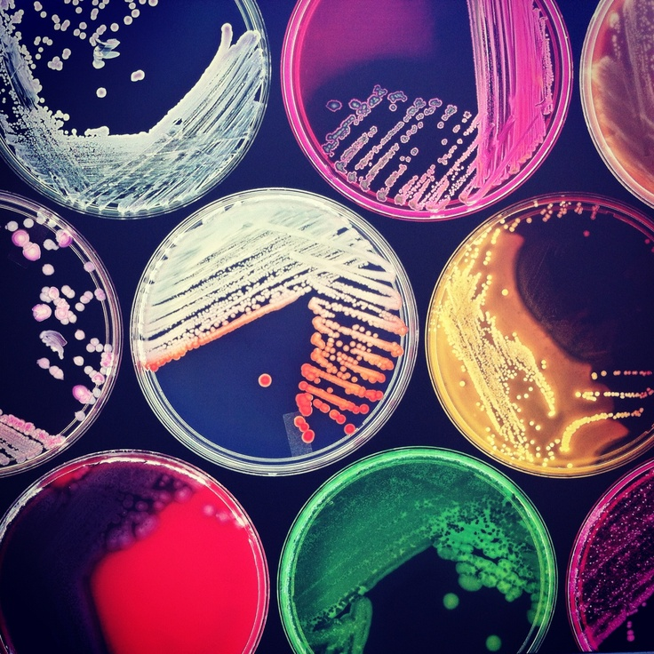
Bacterial population dynamics with beads and bracelets
Heather Kittredge
W.K. Kellogg Biological Station
K-12 Partnership Spring 2017 Workshop

Slide 2
NGSS
Interdependent Relationships in Ecosystems: Animals, Plants, and Their Environment
K-ESS2-2. Construct an argument supported by evidence for how plants and animals (including humans) can change the environment to meet their needs.
Interpret Relationships in an Ecosystem
3-LS4-3. Construct an argument with evidence that in a particular habitat some organisms can survive well, some survive less well, and some cannot survive at all.
Inheritance and Variation of Traits
3-LS1-1. Develop models to describe that organisms have unique and diverse life cycles but all have in common birth, growth, reproduction, and death.
3-LS3-1. Analyze and interpret data to provide evidence that plants and animals have traits inherited from parents and that variation of these traits exists in a group of similar organisms.
3-LS4-2. Use evidence to construct an explanation for how the variations in characteristics among individuals of the same species may provide advantages in surviving, finding mates, and reproducing.

Slide 3
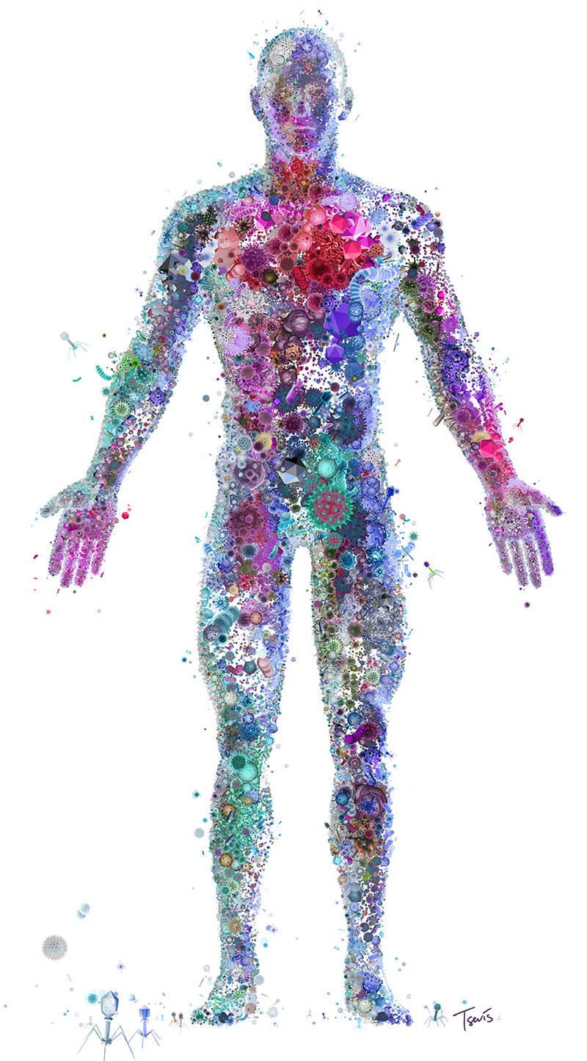
What are bacteria?
Inside this very small cell are all the tools necessary to survive.
They are made of only one cell.
Notes:
Humans are made of many cells, but bacteria are made of only one cell and everything needed to survive is in that one cell therefore bacteria cannot carry out complex processes like humans or other animals can.

Slide 4
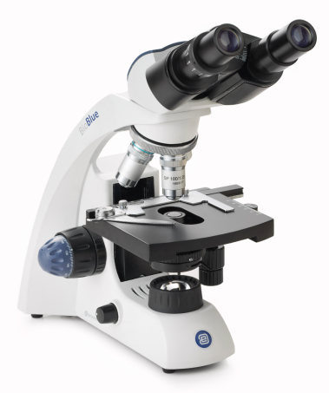
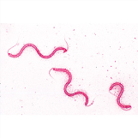
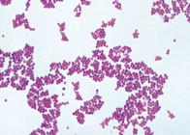
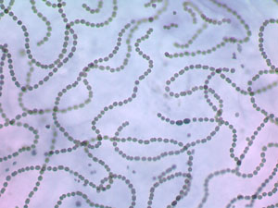
We can’t see bacteria without help from a microscope.
Notes:
Bacteria are microscopic meaning it is impossible for us to see them with the naked eye. On the left are pictures of bacteria that have been stained to be viewed under the microscope. Note the different shapes that bacteria form including circles that create chains, rods and spirochetes that look like tiny worms.

Slide 5
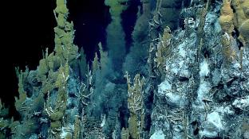
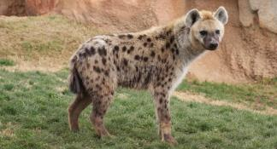
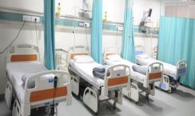
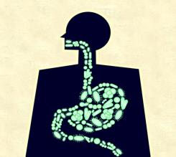
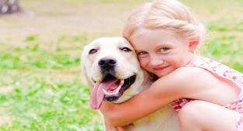
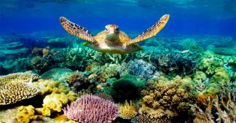
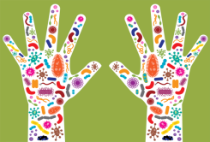
Where do bacteria live?
Notes:
Bacteria live on every surface of the entire planet and they carry out important functions that contribute to human health and environmental cleanliness.

Slide 6
Hospitals
Notes:
Many people think of bacteria as only germs that live in the hospital or are associated with harm and sickness, but really only a small percentage of bacteria are actually harmful to an already healthy human.

Slide 7
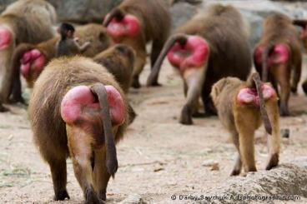
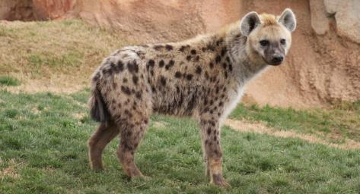
Animals
Notes:
The more we study bacteria, the more we are learning that the microbiome is very important to not only health, but also behavior. We now know that children who interact with dogs at a young age have a lower chance of developing asthma. We also know that bacteria living on the baboon vagina correlates with whether males choose to mate with a female or not and finally the plenary speaker from today Kay Holekamp is starting to study the spotted hyena microbiome to better understand it’s role in behavior.

Slide 8
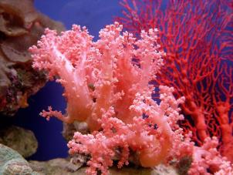
Oceans
Notes:
We now know that bacteria can live deep in the ocean on hydrothermal vents where they withstand extreme temperature and pressure conditions. We are also realizing that bacteria are important symbionts with corals even though for a long time people though that zooxanthella an algae was the only important coral symbiont.

Slide 9
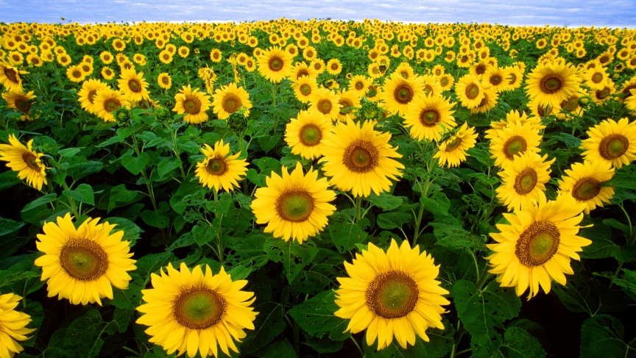
Soil & Plants
Notes:
Bacteria provide nitrogen and carbon to help plants survive and grow. Growing plants in soil without bacteria greatly reduces plant yield.

Slide 10
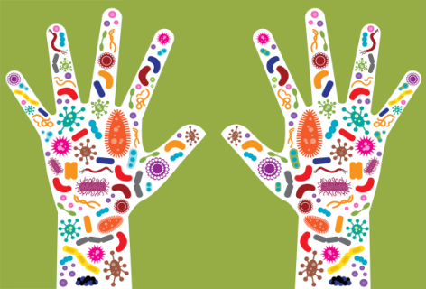
On & in humans
Notes:
Finally, we know that bacteria live on us and in us including in our gut to help control food digestion and on our hands and skin to help our immune system fend of more harmful bacteria. Common example is that babies born through a C-section are often immunodeficient.

Slide 11
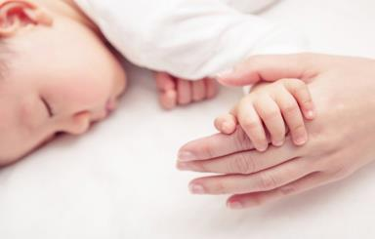
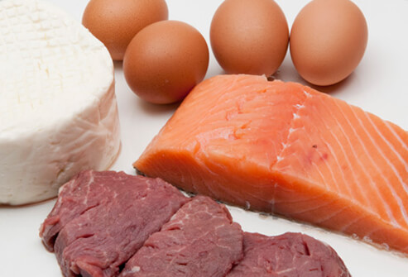
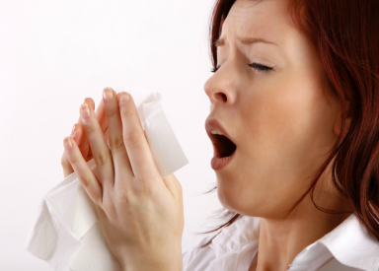
Bacteria that can harm humans.
Notes:
Staphylococcus aureus (MRSA) – very concerning bacteria associated with the infection of cuts
Pseudomonas aeruginosa – opportunistic pathogen that often colonizes the lungs of cystic fibrosis patients.
Listeria – food born pathogen
Salmonella – food born pathogen

Slide 12
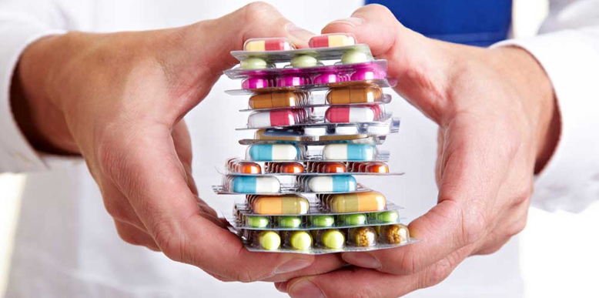
Medicine helps us feel better!
But how does medicine really work?
Antibiotics are a special type of medicine that work on bacteria.

Slide 13
The antibiotic targets a specific part of the bacteria.
Antibiotics can bind to the wall that surrounds and protects a bacterium.
Antibiotics can cut off the points on the stars so the bacteria cannot infect other cells.

Slide 14
Variation in bacterial populations can make bacteria resistant to antibiotics.
Notes:
The thick cell wall prevents the antibiotic from working in the population of bacteria
The lack of points prevents the antibiotic from working on the triangles in the green population
But all the bacteria are still harmful despite these mutations

Slide 15
This variation is caused by mutations that can change the way bacteria look.
Notes:
The way bacteria look is called a phenotype. Here the phenotype is changing from a star to a triangle due to one change in the building blocks of DNA. DNA makes up genes and genes are what control whether the bacteria have a star or triangle phenotype.

Slide 16
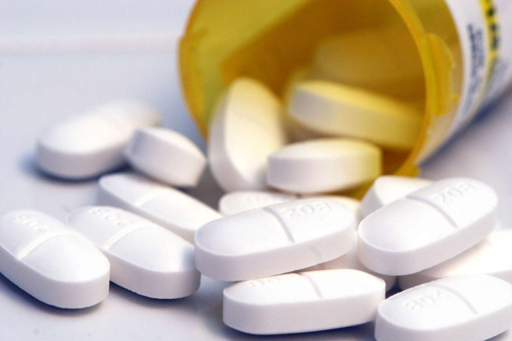
After a mutation arises, antibiotics might become ineffective.

Slide 17
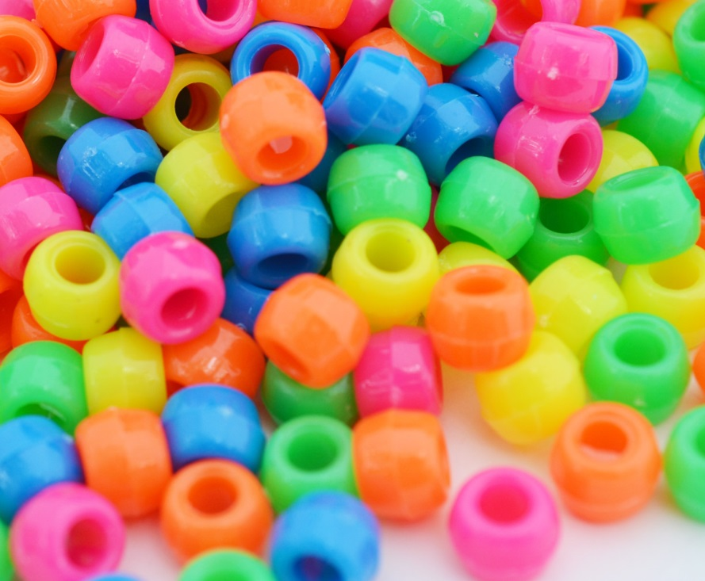
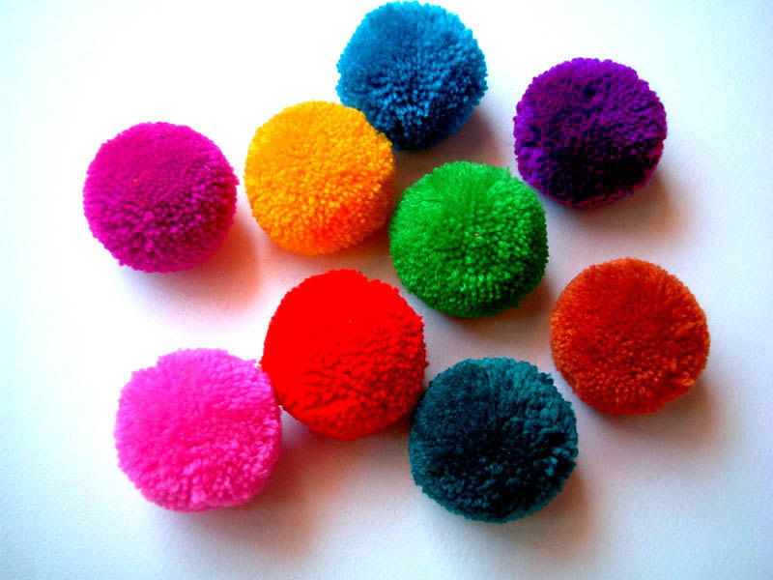
Now let’s use beads and pompoms to better understand the effect of antibiotic resistance on bacterial populations.
Notes:
To set up the game, fill a paper plate with beads and pompoms and have students pick a color then give them the antibiotic which is just a string. Then they can use the string to pick up all the harmful beads, but none of the pompoms. At the end of the game you can have students think about the implications of the pompoms still being in the population after all the beads are gone and how effective the next dose of antibiotics will be.

Slide 18
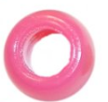
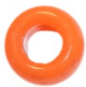
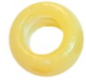
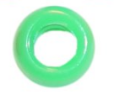
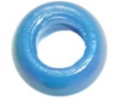
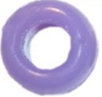
All these bacteria live in your body, but the blue bacteria make you sick.
If you were a scientist, what part of the bead might you want to target with an antibiotic?
Notes:
This color beads will go on the string because it is the target of the antibiotic. We want to emphasize that most bacteria are good, but only this one color is harmful to humans.

Slide 19
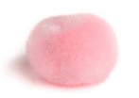
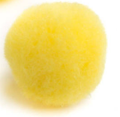
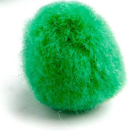
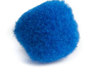
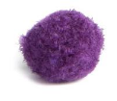
But a mutation in the bead population gives rise to pompoms.

Slide 20
List the variations between the bead and the pompom bacteria?
Will the antibiotic you created still work?
Notes:
First question on the worksheet.

Slide 21
The antibiotic the doctor prescribes targets the hole in the bead, but has no effect on pompoms.

Slide 22
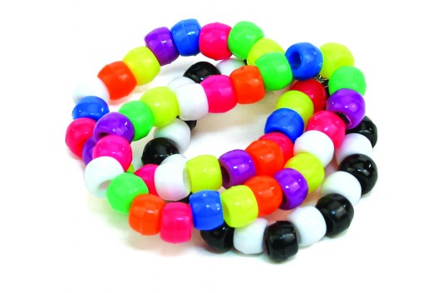
After taking the antibiotic how many blue beads and blue pompoms will be left in the population?
Let’s play a game to help us find out!

