Slide 1
Building a Biological Battery; Electric Fish Know Watt to Do!
Savvas J. Constantinou & Mauricio Losilla Gallant Laboratory Michigan State University

Slide 2
Adaptations
Give organisms advantages in their environment
Evolved by Natural Selection
Notes:
Electric fish are little known animals with very specialized adaptations. For this reason, before talking specifics about electric fish, we want to give a general overview of adaptations with a more familiar example.
Adaptations are traits that evolved and are maintained by Natural Selection. They confer organisms with advantages to surviving or reproducing in their environment.

Slide 3
Feathers
Flight
Saved from harmonyandtravis.com
Notes:
A good example of an adaptation is feathers! We are all very familiarized with feathers. Have you ever thought about why feathers are important to birds?
kids will say: flying!
That is correct, feathers allow birds to fly, and that is certainly an advantage for birds. However, they provide them with several other advantages, and in fact we are sure that feather’s first role wasn’t to let dinosaurs flight (yes, several dinosaurs had feathers! Feathers evolved from dinosaur scales, which were like today’s Reptiles scales.
Ask kids for other benefits birds get from feathers. The next few slides illustrate some examples

Slide 4
Feathers
Camouflage
Photo by HarmonyonPlanetEarth

Slide 5
Feathers
Insulation
Photo by Mike Scott
Notes:
These feathers help these Mute Swan chicks stay warm during cold temperatures

Slide 6
Feathers
Weatherproofing
Photo by U.S. Fish and Wildlife Service – Midwest Region
Notes:
These feathers help this Common Loon stay dry when swimming

Slide 7
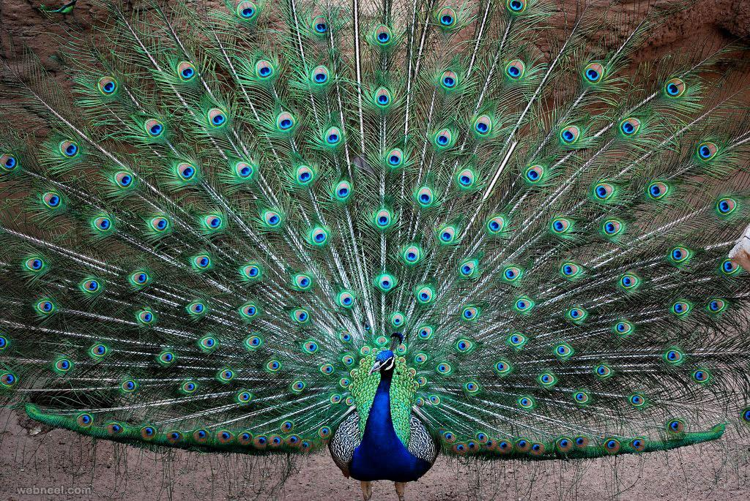
Feathers
Display
Saved from webneel.com
Photo by Tim Laman
Notes:
These feathers help these male birds of paradise and peacock attract females

Slide 8
Electric Fish
They have a very special adaptation: they can produce electricity!
We call this electricity an electrical discharge
Notes:
That’s right. Electric fish can make electricity! Let’s talk more about this!

Slide 9
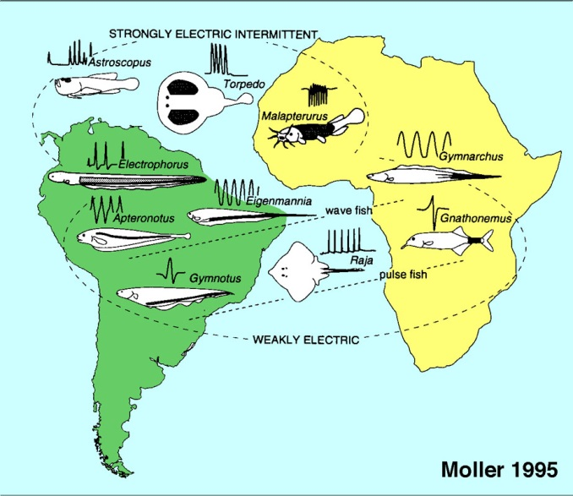
Electric Fish
This adaptation has evolved at least 6 times
This means that not all electric fish are related, unlike birds!
Notes:
This cartoon map illustrates each of the electric fish groups (and I will talk about them in a sec) and where they live. Most species live in freshwaters of Africa and Central and South America, and a few species are marine

Slide 10
Electric Rays
Photo by Philippe Guillaume
Notes:
For each group I will present pictures, cartoons with the electric organs colored with grey, and a trace of how a representative electric discharge from the group looks like on a computer, after measuring it with specialized equipment. I will use these cartoons later to reference each group.
Electric rays live in the ocean, They feed on invertebrates and small fish. They lie in wait for prey below the sand
This is what their electric signal looks like on a computer

Slide 11
Electric Skates
Photo by Andy Martinez_NOAA
Notes:
Electric skates live in the ocean, They feed on invertebrates and small fish. They lie in wait for prey below the sand.
This is what their electric signal looks like on a computer
Rays and skates look similar, but did you know they are also somewhat related to sharks! Their skeletons are made of cartilage instead of bones!

Slide 12
Electric Stargazers
Photo by Canvasman21 at English Wikipedia
Notes:
Electric stargazers live in the ocean, they feed on small fish. They lie in wait for prey below the sand. Their eyes are situated on top of the head and poke up through the sand, hence the name stargazer.
This is what their electric signal looks like on a computer
Stargazers are venemous, they have two large venomous spines behind their head

Slide 13
Electric Catfish
Photo by Stan Shebs
Notes:
Electric catfish are found freshwater rivers in Africa. They prey on other fish, invertebrates, fish eggs.The largest can grow to about 1.2 m (4 ft) long, but most species are far smaller than 1 foot.
Some people say that the ancient Egyptians used the electric shock from them when treating arthritis pain. The Egyptians have depicted the fish in their mural paintings.
This is what their electric signal looks like on a computer

Slide 14
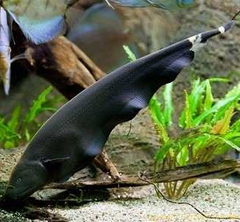
Knifefish
Photo by Albert Lab Univ Lousiana
Photo by Albert Lab Univ Lousiana
Google Images
Notes:
Knifefish live in freshwater rivers in Central and South America.
hundreds of species. Prey on invertebrates and small fish.
This is what their electric signal looks like on a computer

Slide 15
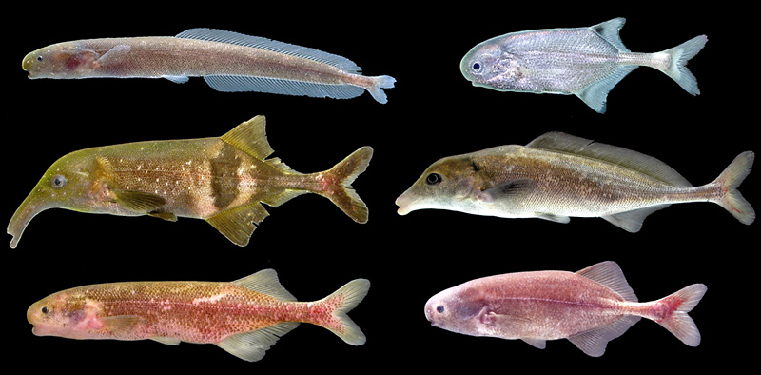
freshwater elephantfish
Photos by John P Sullivan & Carl D. Hopkins
Notes:
elephantfish live in freshwater rivers in Africa. Hundreds of species.
hundreds of species. Prey on invertebrates and small fish.
This is what their electric signal looks like on a computer

Slide 16
Is this an adaptation?
Navigation
Communication
Defense from predators
Stun prey
Weakly electric fish
Strongly electric fish
Notes:
Recall that I said that adaptations give organisms advantages in their environments. A great question to ask is what benefits electric fish get from producing electricity. What benefits do you think fish can get?
These are the main benefits electric fish can get from their discharges. Not every electric fish uses electricity for all these actions. Navigation and Communication require very little electricity. Electric fish that only produce very little electricity are called weakly electric fish. The majority of electric fish belong in this group
Defense + Stunning prey require much more electricity. Fish that can achieve this are called strongly electric fish. Only a few electric fish are strongly electric.
Now let me explain these benefits some more

Slide 17
Navigation
This means to be able to tell apart objects, find food and shelter, detect dangers…
Many electric fish are nocturnal and live in murky waters. Sight is not very useful under these conditions!
Notes:
We humans (and many more animals) heavily relay on sight to do this things. But electric fish can’t do that, because:

Slide 18
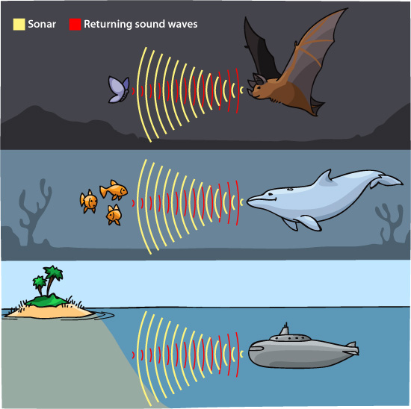
Navigation
Saved from askabiologist.asu.edu/echolocation
Notes:
The electrical discharge helps electric fish navigate. It works very similar to a radar or a sonar. Bats, whales, dolphins and a few other animals use similar adaptations to navigate their environments.
The way this works is that a signal is emitted into the environment (yellow lines), objects in the environment interact with it, and the sender can detect them because of these interactions (red lines)

Slide 19
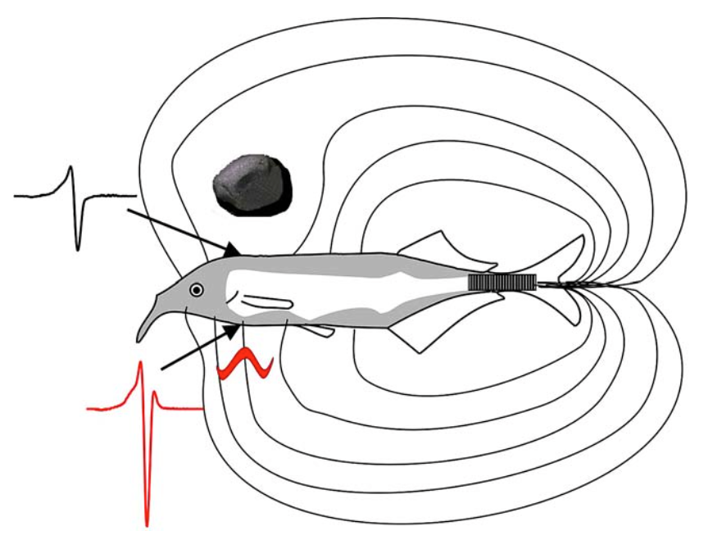
Navigation
von der Emde (2006) fig 1
Notes:
In the case of electric fish, the signal sent into the environment is the electrical discharge.
The electric discharge is produced in the electric organ, that in mormyrid fish it’s located at the base of the tail. This cartoon is a mormyrid fish, its electric organ is the black rectangle at the base of the tail, and its electroreceptors are colored with grey. These are distributed along the body.
The electric discharge produces an electric field (these are the lines in the cartoon). This field interacts with objects and fish detect this interaction (red, black traces). Fish can learn the size, shape, distance of objects, and weather they are alive or not!

Slide 20
Communication
Electric fish can detect the electric signals emitted by other fish
They can communicate things like: species they belong to, their size, sex, breeding status
Notes:
They have to be close to each other
Using the electric discharges, they can communicate things like…

Slide 21
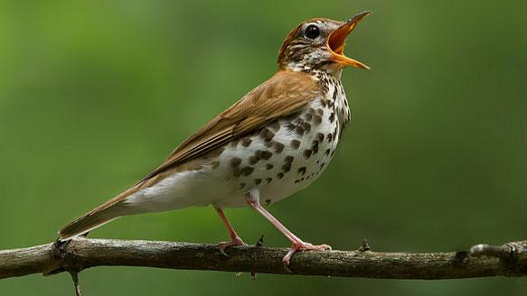
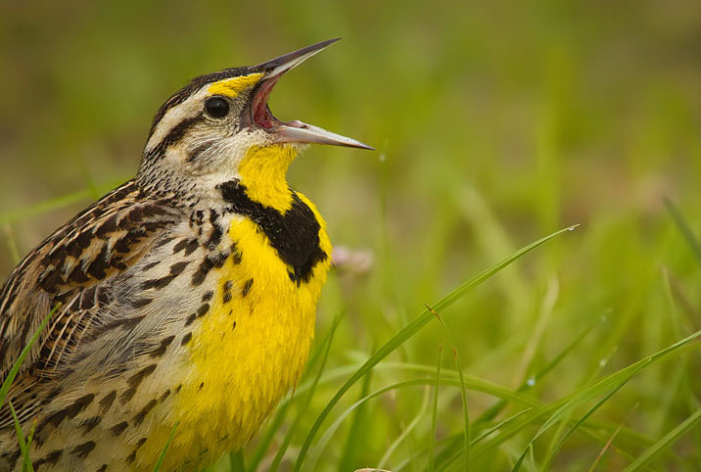
Communication
Photo by Larry Keller
Photo by Corey Hayes
Photo by Scott Helfrich
Photo by Mark Schwall
Notes:
It works pretty much the same way as birds for example. We have all heard birds singing. They reason they sing is to communicate with other birds. Many electric fish do this as well.

Slide 22
Communication
Saved from 2e.mindsmachine.com/asf15.03.html
Notes:
Each bird species has its own song. this is how bird songs look on a computer

Slide 23
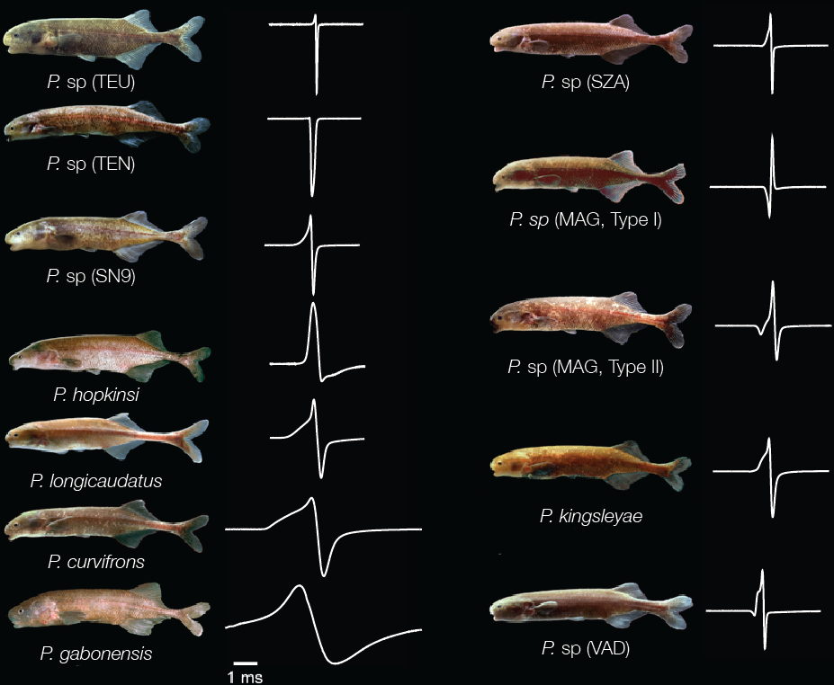
Communication
Gallant Lab, MSU
Notes:
the electric signal from each electric fish species is also unique. These are all different electric fish species and their discharges. Notice how different their discharges are, compared to their physical appearance.
Fish prefer to communicate with fish that have the same discharge. With enough time, this preference can lead to the evolution of new species.

Slide 24
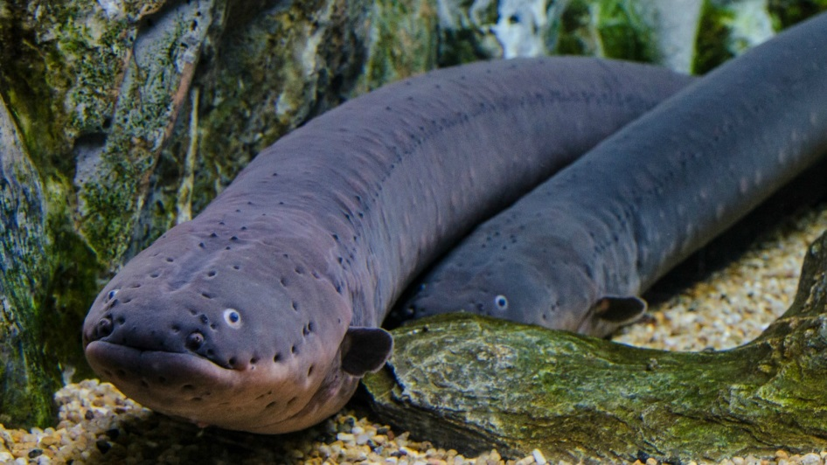
Defense & Stunning prey
These fish produce strong electric discharges
Electric eel, electric catfish, and electric rays
Electric eels can make discharges of ~650 V
Saved from kids.nationalgeographic.com
Notes:
Very few fish are strongly electric.
electric eels: 650V +5 times the voltage of a house outlet

Slide 25
Defense & Stunning prey
Video by Kenneth Catania - Vanderbilt University
Notes:
Let’s look at this short video of an electric eel hunting.
After video: It was very quick right!

Slide 26
Defense & Stunning prey
Video by Kenneth Catania - Vanderbilt University
Notes:
Let’s look at this similar video but on slow motion.
The red frames indicate high voltage discharges.
Notice how the prey stops moving after receiving the discharge! The electricity makes it lose control of its muscles

Slide 27
Exercise 1

Slide 28
Draw a mormyrid in the natural environment
Notes:
Transition slide into Exercise 1. Leave up

Slide 29
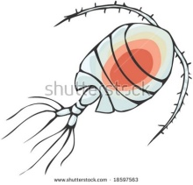
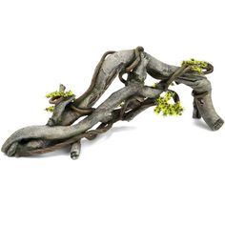
Objects in an African stream
Predators
Prey
Aquatic plants
Logs and rocks
Bloodworms
Copepods
Notes:
Reminder slide 1 Image credits: blood worm and rock- von der Emde, 2006 paper: “Non-visual environmental imaging and object detection through active electrolocation in weakly electric fish” Copepod: shutterstock.com 18597563 seaweeds: clipartfest.com

Slide 30
Draw an electric field
Notes:
Reminder slide 2 Image credits: von der Emde, 2006 paper: “Non-visual environmental imaging and object detection through active electrolocation in weakly electric fish”

Slide 31
Pick what electric discharge your fish makes!
Biphasic Bi means two
Triphasic Tri means three
1
2
1
2
3
Notes:
Image credits: Gallant Lab

Slide 32
Part II

Slide 33
Building a Biological Battery; Electric Fish Know Watt to Do!
How did evolution produce a biological battery?

Slide 34
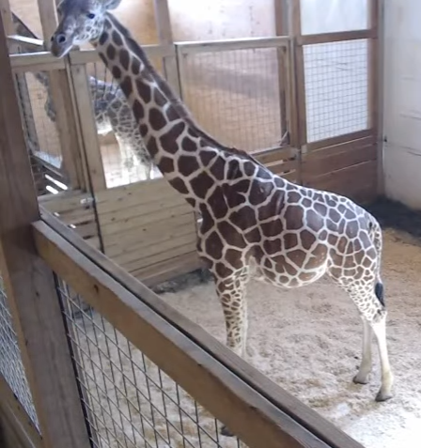
Serial evolution/step by step evolution
Notes:
Introduce the strange animal that is the giraffe- if done close to 2017 students may remember April the giraffe pictured here. Introduce the oddity of the elongated neck. Image credit: Webcam, Animal Adventure park- image from Fox8 news source

Slide 35
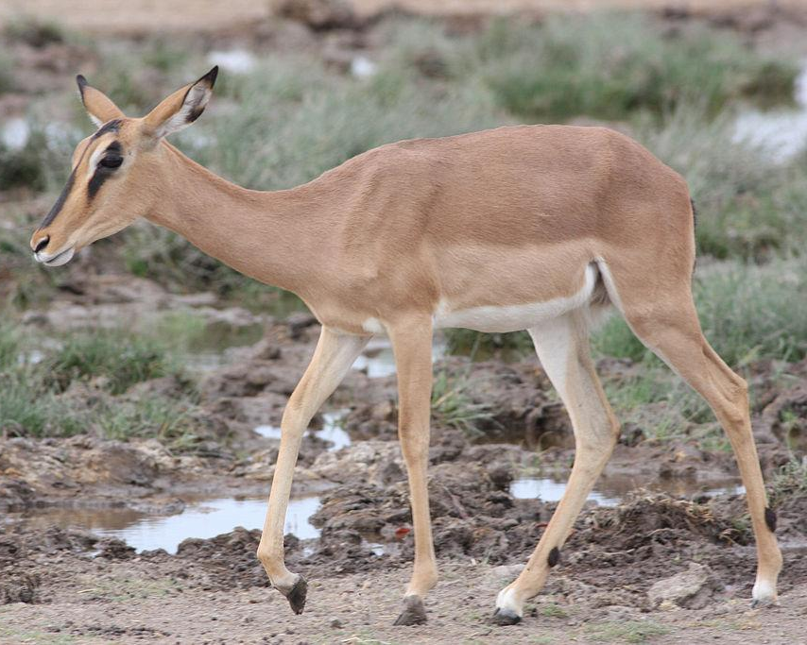
Most evolution occurs in small pieces, step by step: How did the giraffe get such a long neck?
Notes:
How did the giraffe get such a long neck? It is thought that the extinct ancestor of giraffes had a short neck, and probably looked somewhat like the modern day impala The giraffe ancestor was competing with other animals that were eating the same food sources.
Image from wikipedia.com- creative commons license

Slide 36
Most evolution occurs in small pieces, step by step: How did the giraffe get such a long neck?
Notes:
A mutation caused the neck bones to become slightly longer in a population of the giraffe ancestors. It is believed that when food became scarce, they were able to reach food that the shorter necked animals could not and had an advantage that allowed them to survive. This selected for longer necks in some of the ancestors as only those with longer necks were more likely to mate with each other as most of the longer neck individuals would not survive. This was the first step in the evolution of the long neck. Image from Greg Stevens: http://gregstevens.com/2012/12/18/evolution-qa-why-did-only-humans-become-intelligent/

Slide 37
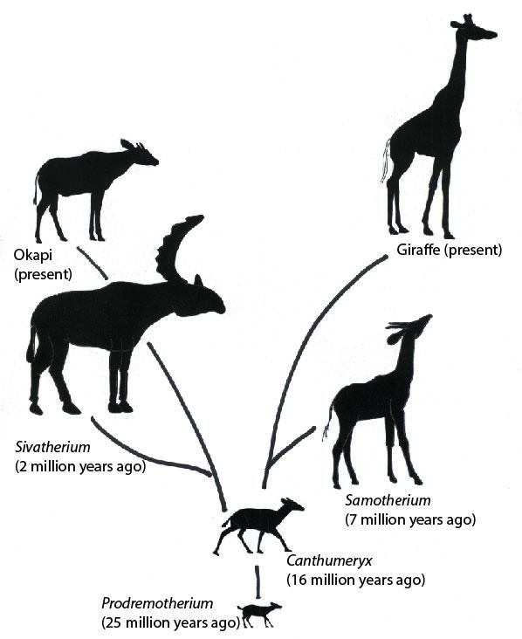
Notes:
Over evolutionary time, animals became different enough to become different species. Two main lineages survived, one that led to the modern day okapi, and the other led to the modern day giraffe. The okapi has a slightly elongated neck and shared the same ancestor as giraffes. They share many similarities in appearance and behavior due to their common ancestor and similar environmental challenges. Image credit: https://www.sciencenews.org/blog/wild-things/how-giraffe-got-its-long-neck

Slide 38
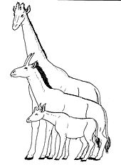
Notes:
The fossil record helps to illuminate how small changes occurred that led to the giraffe having a long neck. The okapi has a slightly longer neck compared to other living animals like water buffalo and impalas, the extinct Sam-o-ther-e-um (Samotherium) shows an intermediate length to its neck compared to the okapi and giraffe. This demonstrates the step by step nature of evolution; already existing structures are modified in small incremental steps Image credits: https://en.wikipedia.org/wiki/Giraffe- creative commons license

Slide 39
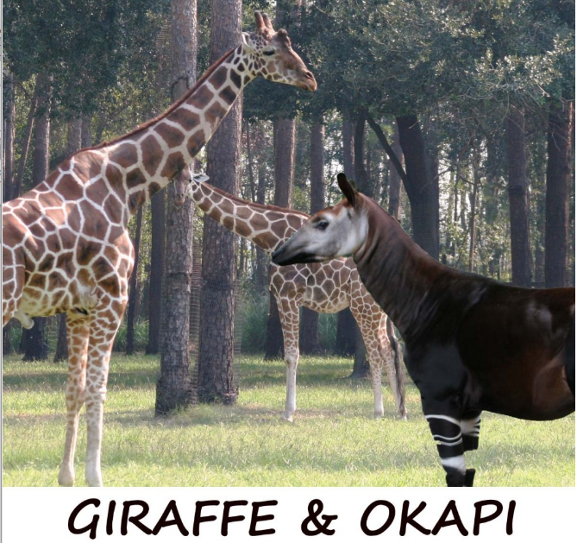
Most evolution occurs in small pieces, step by step: How did the giraffe get such a long neck?
Notes:
What actually causes the neck length to increase in the giraffe and okapi? What were the initial mutations that allowed for the evolutionary trajectory of these animals?
Image credit: www.whiteoakwildlife.org/giraffe-and-okapi/

Slide 40
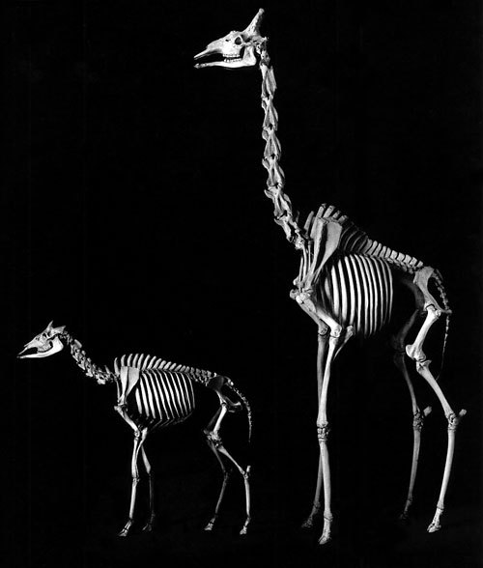
Most evolution occurs in small pieces, step by step: How did the giraffe get such a long neck?
Notes:
Here is what the giraffe and okapi skeletons look like. The bones in our neck that hold up our heads and make up our spine are called vertebrae.
Since bones make up necks, what are two easy explanations for how giraffes could get longer necks?
Image credit: https://unrealnature.wordpress.com/2009/08/18/dining-and-dancing/

Slide 41
Most evolution occurs in small pieces, step by step: How did the giraffe get such a long neck?
More bones
Longer bones
Notes:
It would be possible for a larger neck to exist by adding more bones to increase the length of the neck. Or If each bone was made longer, the neck could increase in length
Image credit: https://en.wikipedia.org/wiki/Giraffe- creative commons license

Slide 42
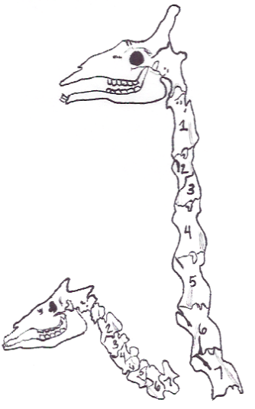
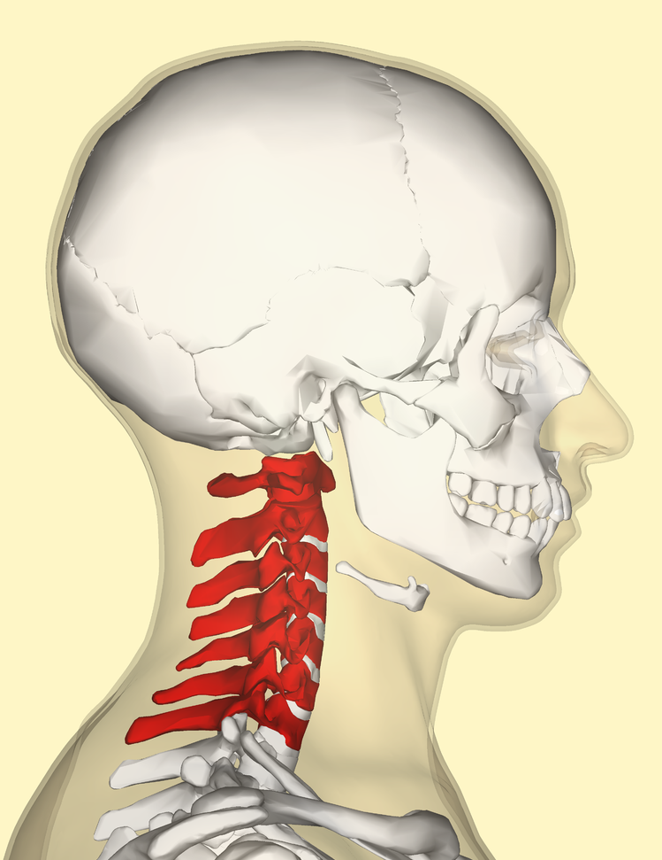
Most evolution occurs in small pieces, step by step: How did the giraffe get such a long neck?
Notes:
Well it turns out that the giraffe has such a long neck due to long bones! The number of vertebrae that make up the neck is actually the same between okapis, giraffes AND humans! There are 7 total vertebrae and this is true of almost all known mammals. What has happened in giraffes is lengthening of each vertebrae during development and throughout life, causing the abnormally long neck. Evolution was able to build upon the already existing body plan and bone structure of the giraffe ancestors, and slowly overtime make small changes that lead to increasing sizes of the neck vertebrae.
Image credit: https://en.wikipedia.org/wiki/Giraffe & https://en.wikipedia.org/wiki/Cervical_vertebrae- creative commons licenses

Slide 43
So how did mormyrid fish become electric?
Where in our bodies do we produce electricity?
Nerves
Muscle
Notes:
So because evolutionary novelties are generated slowly from preexisting structures,
how did the mormyrid gain the ability to produce electricity? If an organ that emits electricity is the known evolutionary endpoint, the best place to start developing that organ is by modifying cells that already produce electricity. Where in our body do we produce small amounts of electricity, even as humans? In our nerves we produce electricity. It is one of the components that allow our nerves to transmit information around our body. The other cells that produce electric currents are muscle tissue, all the muscles in our body, including the heart. Muscles use electricity to synchronize contraction. *can mention defibrillators (paddles) and restarting the heart if students will know this Figure credits: http://www.humanillnesses.com/Behavioral-Health-A-Br/The-Brain-and-Nervous-System.html http://www.stanshealth.com/2008/04/interesting-facts-about-muscles.html

Slide 44
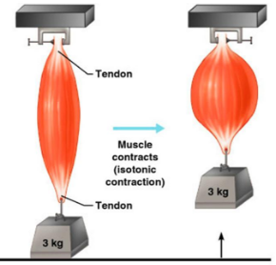
So how did mormyrid fish become electric?
Electric organs are derived from muscle.
Notes:
A common ancestor that gave rise to the current day mormyrids did not have an electric organ. Instead, mutations occurred in a fish/population where some of the fish’s muscle became better at producing electricity. This was done in a step by step fashion, much like the elongation of the neck of giraffes, or the appearance and specialization of feathers in birds. Some key processes occurred to allow for increased electricity production and decreased muscle function, including making bigger cells with a different shape, and stopping the cells from contracting when they made electricity. The common ancestor of mormyrids really just had “electric muscle” and not the electric organ with electrocytes that current day mormyrids have. These initial mutations did not affect the fish, or they may have been slightly beneficial, so they were passed on to the offspring. Image copyright: 2001 Benjamin Cummings, an imprint of Addison Wesley Longman. Inc. image credits: http://www.austincc.edu/rfofi/NursingRvw/PhysText/Muscle.html

Slide 45
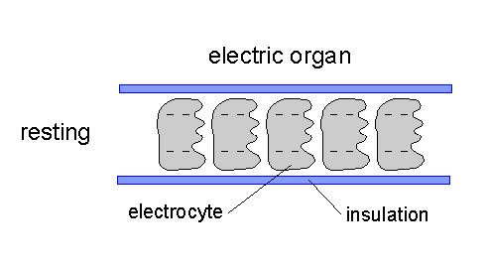
So how did mormyrid electric fish become electric?
Notes:
To produce specialized electrocytes, the mutations that produced the “electric muscle” in the common ancestor were selected on and eventually provided an advantage by allowing the fish to sense the environment even in the dark and when waters are muddy. Like the extending neck of extinct giraffe ancestors, fish with “electric muscle” were better able to survive and pass down this adaptation to their young. Overtime and after many small steps, the mormyrids were able to produce cells that were very specialized and specified called electrocytes. They start as muscle cells and then become electrocytes after the fish is born. The most simple electrocyte discharges electricity by actively moving small charged particles into the cell from one side. This produces a very small amount of electricity. This is still more than a muscle cell or nerve, but one cell still does not produces enough electricity to easily measure. Figure from: Kawasaki lab, university of virginia: http://people.virginia.edu/~mk3u/mk_lab/electric_fish_E.htm

Slide 46
So how did mormyrid electric fish become electric?
Notes:
In order to produce enough electricity to generate a true electric field around the fish, electrocytes are stacked together and arranged in a pattern such that their electrical discharge occurs all at once and all together is powerful enough to project into the surrounding environment. Figure from: Kawasaki lab, university of virginia: http://people.virginia.edu/~mk3u/mk_lab/electric_fish_E.htm

Slide 47
How might have the electric organ evolved?
??
??
??
??
Notes:
What may have occurred is that a mutation arose in a small group of muscle cells within the fish’s tail (red outline) that caused them to be slightly more electric than normal muscle cells. The fish weren’t affected by the mutation or were able to sense the weak field that was produced, and survived better, passing down the “mutation” until it became an adaptation.

Slide 48
How might have the electric organ evolved?
Notes:
Small changes began to occur that decreased the contraction of the muscle, allowing more electrical output.

Slide 49
How might have the electric organ evolved?
Notes:
Likely more “electric muscle” cells were also packed into the same area as cell shape changes took place, allowing increased electrical output

Slide 50
How might have the electric organ evolved?
Notes:
Eventually, the cells became specialized and developed into the electrocytes we know and see today. It is important to remember that this is a random, step by step process. Evolution doesn’t “try” to produce anything. Instead mutations arise that either help or hinder survival based on the environment, and the animals that survive have a chance for the small mutations to be passed down, and then go through more rounds of selection as more step by step mutations occur.

Slide 51
Exercise 2

