Slide 1
Fun with the Sun:
Patterns from the Sky
Kara Haas (Kellogg Biological Station – MSU)
KBS K-12 Partnership
The Kellogg Edge: Breaking Boundaries in Ecology and Evolution Education
April 18, 2017
Notes:
Thank you for inviting me.
Central question — how do we make science more meaningful for learners?

Slide 2
Let’s get to know each other
Who is in the room?
grade levels
part of the state
How comfortable are you with Michigan Science Standards?
Very
Somewhat
Little

Slide 3
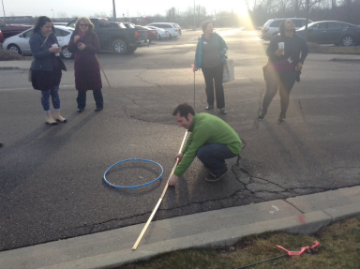
What will we do today?
Discuss what’s new in the Michigan Science Standards (MSS) for K-5
GO OUTSIDE and try out a few activities that could help students identify patterns in shadows!

Slide 4
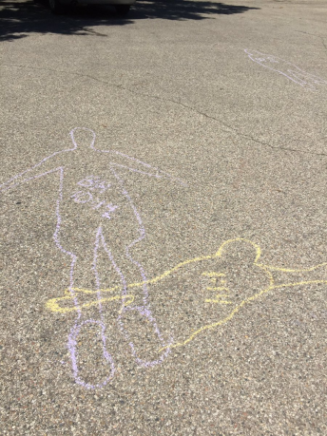
Bonus: Sidewalk Chalk Art!

Slide 5
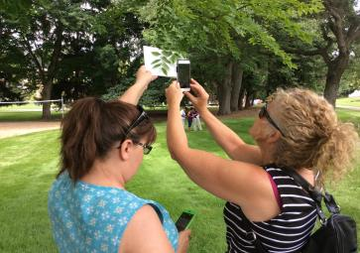
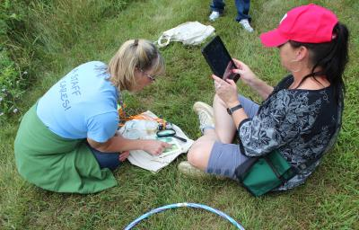
Teaching Science Outdoors
A week long professional development program for K-5 Teachers
Focused on building confidence and creativity with content
Notes:
The mission of the W.K. Kellogg Biological Station (KBS) is to increase our understanding of natural and managed ecosystems and their linkages to society. This entails three main integrative activities:
• Promote and support multi-disciplinary research in ecology, agriculture, natural resources and the environment, across the continuum of basic to applied research.
• Provide MSU students with inquiry-based educational opportunities in ecology, agriculture, natural resources, and the environment.
• Provide outreach programs that bring KBS expertise to bear on environmental issues of public importance.

Slide 6
CREATE for STEM Institute
Based at Michigan State University
COLLABORATIVE research and innovation projects
Curriculum, teaching strategies, assessment development
Elementary grades through undergraduate courses
Grounded in 3-dimensional learning, project-based learning, NGSS/ Michigan Science Standards
Partners in K-12 schools, higher education, research institutes, community organizations
In Michigan, across the U.S., and around the world
Funding from MSU, NSF, NIH, foundations

Slide 7
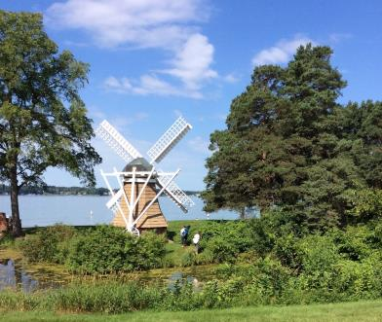
MSU’s largest off-campus research and education complex.
Over 3200 acres of forest, agricultural fields, wetland, lake and prairie habitat.
Kellogg Bird Sanctuary
Kellogg Farm and Pasture Dairy
Manor House and Conference Center
13 faculty research in ecology, evolutionary biology, agriculture and conservation biology

Slide 8
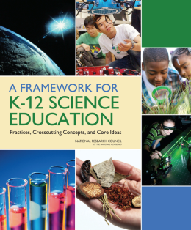
What’s new in the the Michigan Science Standards and Framework
Focus on explaining phenomena or designing solutions to problems
3-Dimensional Learning
Organized around disciplinary core explanatory ideas
Central role of scientific and engineering practices
Use of crosscutting concepts
Instruction builds towards performance expectations
Coherence: building and applying ideas across time
Engineering as a DCI

Slide 9
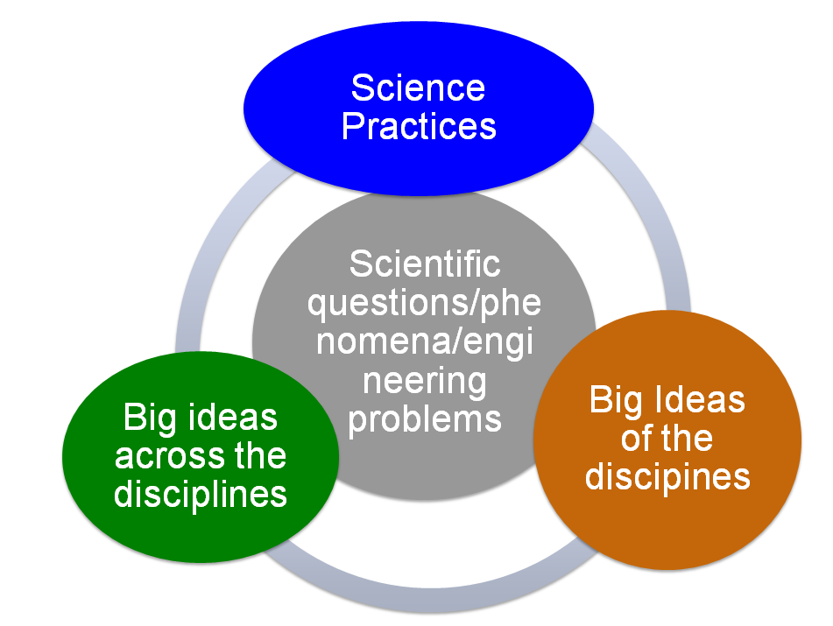
What’s new in the the Michigan Science Standards and Framework
Figuring out/Making sense of what is happening
Focus on explaining phenomena or designing solutions to problems
3-Dimensional Learning
Organized around disciplinary core explanatory ideas
Central role of scientific and engineering practices
Use of crosscutting concepts
Instruction builds towards performance expectations
Coherence: building and applying ideas across time
Engineering as a DCI

Slide 10
“Figuring Out” vs. “Learning About”
Explore Scientific Ideas
Explanatory ideas are important so that students are figuring out phenomena and not just learning about facts and details.
Science and engineering practices build explanatory ideas.
Make Sense of Phenomena
Notes:
Brief review of slide

Slide 11
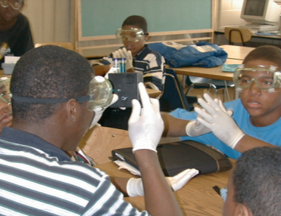
Project-Based Learning (PBL)
Project-based learning allows students to
learn by doing,
apply ideas, and
solve problems.
In so doing, students engage in real-world activities similar to those of professional scientists.
Krajcik, J.S. and Shin, N. (2014) ‘Project-Based Learning’, in Sawyer, R.K. (ed.) The Cambridge Handbook of the Learning Sciences:. Cambridge: Cambridge University Press, pp. 275–297.

Slide 12
Project-Based Learning (PBL)
Learning sciences research has found that teaching integrated knowledge allows students to:
draw on their understanding to solve problems,
make decisions, and
learn new ideas.
Drawing on this research, the goal of PBL is to increase students’ engagement and help them develop deeper understanding of important ideas.
Krajcik, J.S. and Shin, N. (2014) ‘Project-Based Learning’, in Sawyer, R.K. (ed.) The Cambridge Handbook of the Learning Sciences:. Cambridge: Cambridge University Press, pp. 275–297.

Slide 13
6 Key Features of PBL
Students:
Start with a driving question about a phenomena or a problem to be solved.
Focus on learning goals that require a demonstration of mastery on key science standards and assessments.
Explore the driving question by participating in scientific practices – processes of problem solving that are central to expert performance in the discipline
Engage in collaborative activities, along with teachers and community members, to find solutions to the driving question.
Are scaffolded with learning technologies that help them participate in activities normally beyond their ability.
Create a set of tangible products that address the driving question.

Slide 14
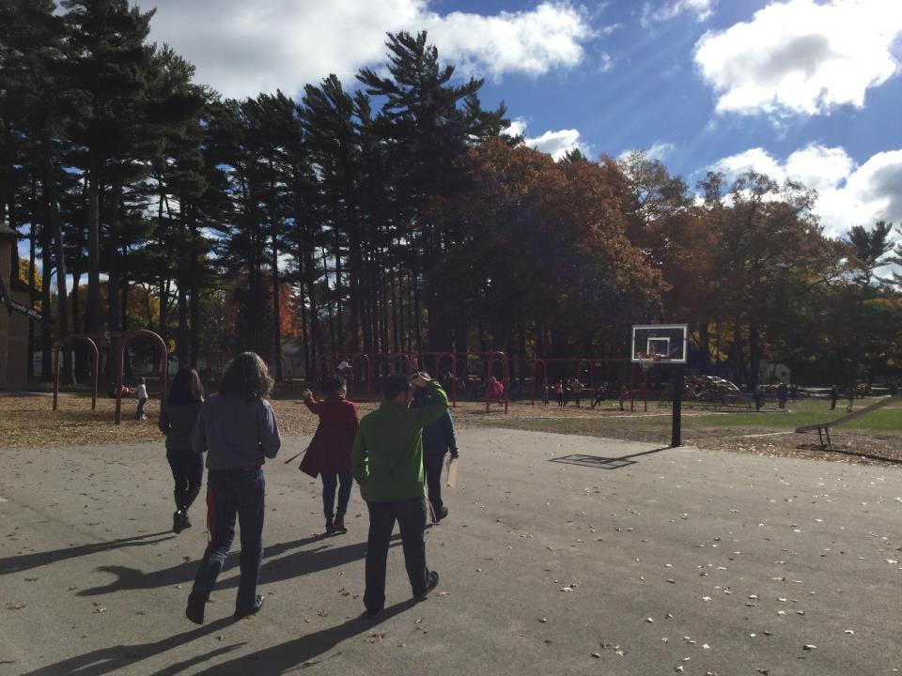
Sample of a Fifth Grade Investigation
Ealy Elementary –
Whitehall, MI

Slide 15
What does PBL look like in the classroom?
“ His eyes fell upon the stone ridge to his left and he thought at first he should build his shelter against the stone. But before that he decided to check out the far side of the ridge and that was where he got lucky.
Using the sun and the fact that it rose in the east and set in the west, he decided that the far side was the northern side of the ridge.”
Hatchet, Gary Paulsen

Slide 16
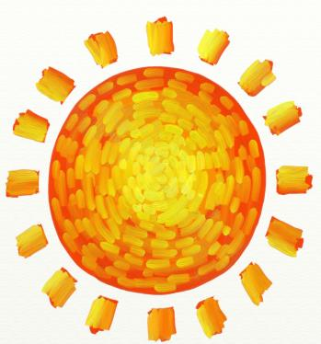
Students question: “How did Brian know where North was?”
Can we replicate how Brian used the sun in the story, Hatchet, to decide what direction north is, as well as the other cardinal directions?
Notes:
Driving question! Questions were kept track of on a dry erase board in the classroom, Gabe will take a recreate and take a picture of.

Slide 17
Observing a Phenomenon in Our Courtyard
Notes:
Scientific practice! Observation. After observations, students would engage in productive talk with each other to revise models.

Slide 18
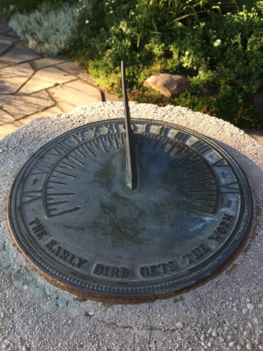
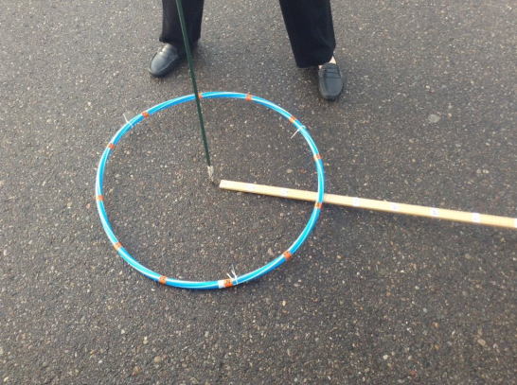

Slide 19
Notes:
Scaffolded with learning technologies, used google sheets and docs to collect, share and display data

Slide 20
Notes:
Collaborative activities, used degrees from math class to increase the accuracy of the observations

Slide 22
Let’s take it outside!
Field Assignment: How can we make accurate observations of the Sun’s location and movement? Are there any patterns that emerge from our observations?
Quiet observation
Sun Scavenger Hunt
Driving Questions
Create Driving Questions Board
Sidewalk Shadows
Shadow Journal
Create a sundial

Slide 23
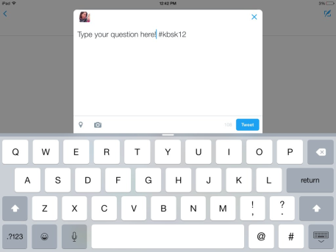
How to tweet observations
Press the
2. Press the
3. Take photo of observation!
4. Type question or description
5. #KBSK12

Slide 24
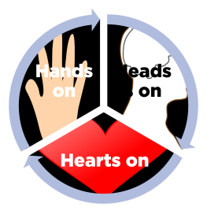
Wrap up/reflection
Hands on, Heads on, Hearts on
How were your hands, head and heart engaged in this activity?
For your grade level, how do you envision your students hands, heads and hearts would be engaged?

Slide 25
Thanks for coming!
Kara Haas (Kellogg Biological Station – MSU)
KBS K-12 Partnership
The Kellogg Edge: Breaking Boundaries in Ecology and Evolution Education
April 18, 2017
Notes:
Thank you for inviting me.
Central question — how do we make science more meaningful for learners?

Slide 26
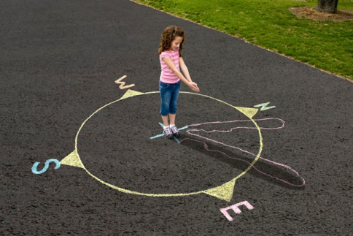
Using a Model to Explain the Phenomenon We are Observing
Notes:
Tangible products, created a model with a globe and sun on a toothpick - could share with each other and share with teacher as a demonstration of learning. Students used productive talk while updating their models.

Slide 27
