Slide 1
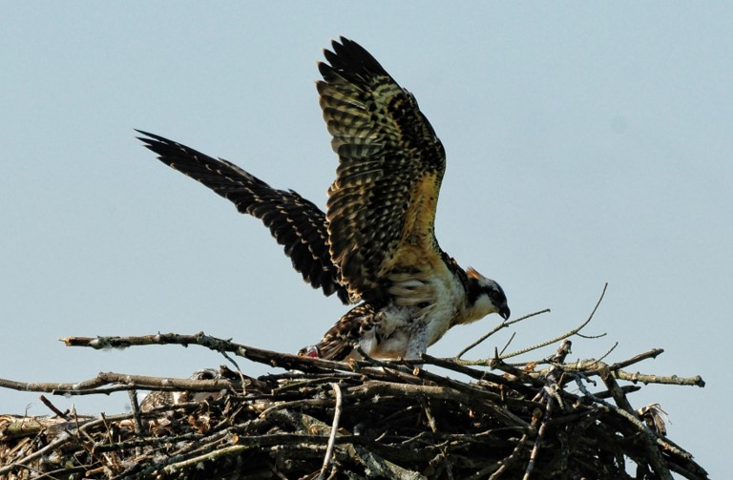
Osprey juvenile on the Lux Arbor nesting platform on Crooked Lake
Photo by Larry Burdick, 2017

Slide 2
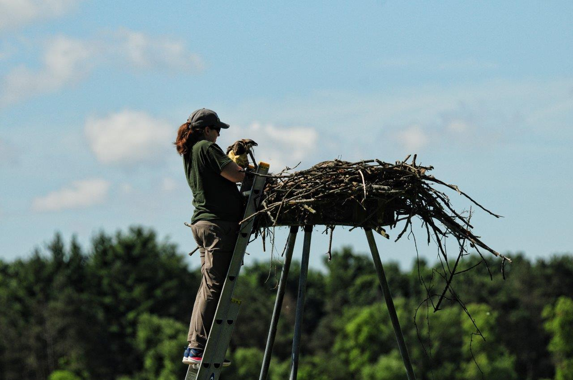
Sara from the Kellogg Bird Sanctuary removing
an osprey from the nest for banding.
Photo by Larry Burdick, 2017

Slide 3
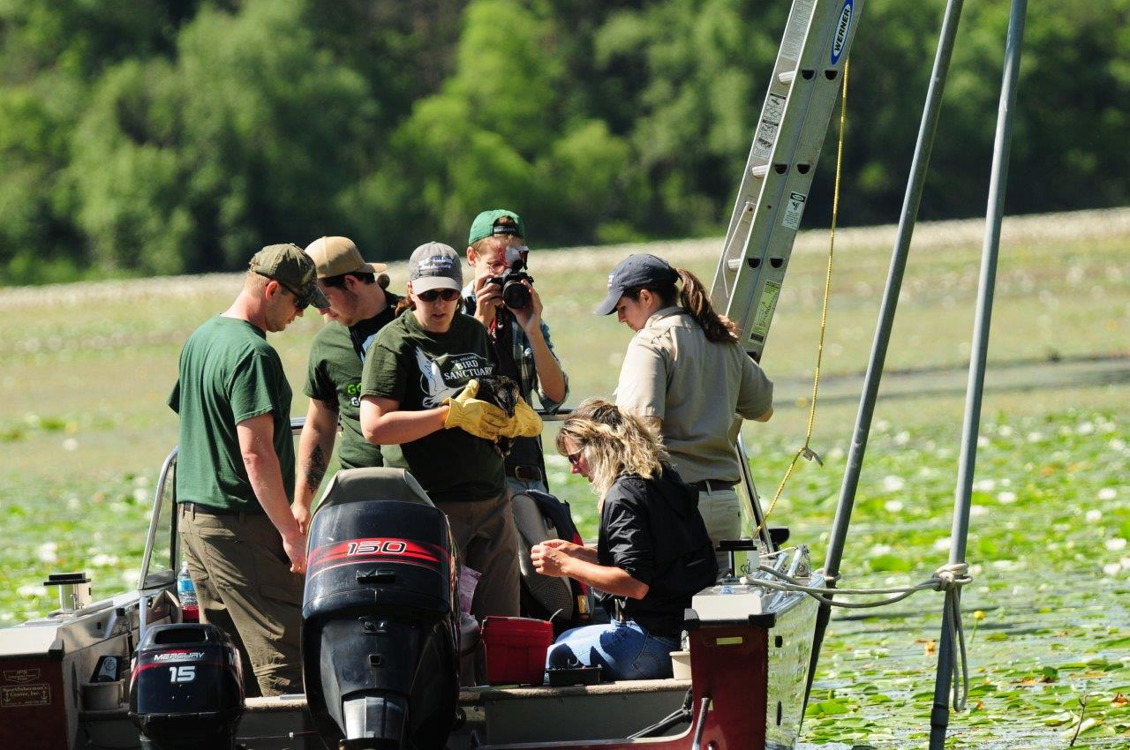
Sara from the Kellogg Bird Sanctuary holds the osprey as
Dr. Julie from the Michigan DNR gets the materials ready.
Photo by Larry Burdick, 2017

Slide 4
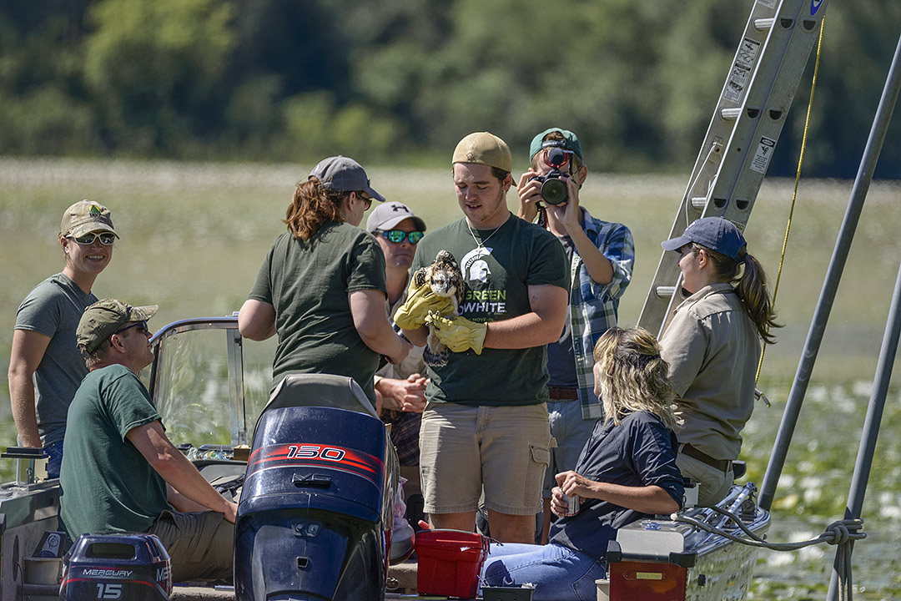
Sara from the Kellogg Bird Sanctuary instructing the Avian Care Intern, Brenden, on how to properly handle the osprey.
Photo by Roy Van Loo, Jr., 2017

Slide 5
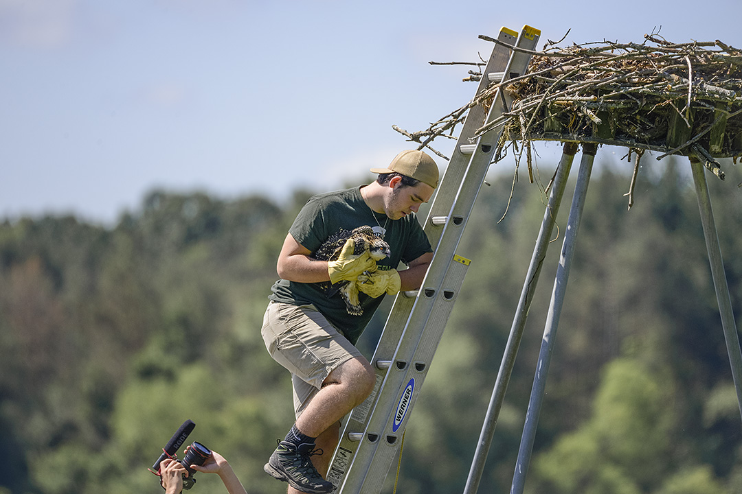
Kellogg Bird Sanctuary Avian Care Intern, Brenden,
returning the banded osprey juvenile to the nest.
Photo by Roy Van Loo, Jr., 2017

Slide 6
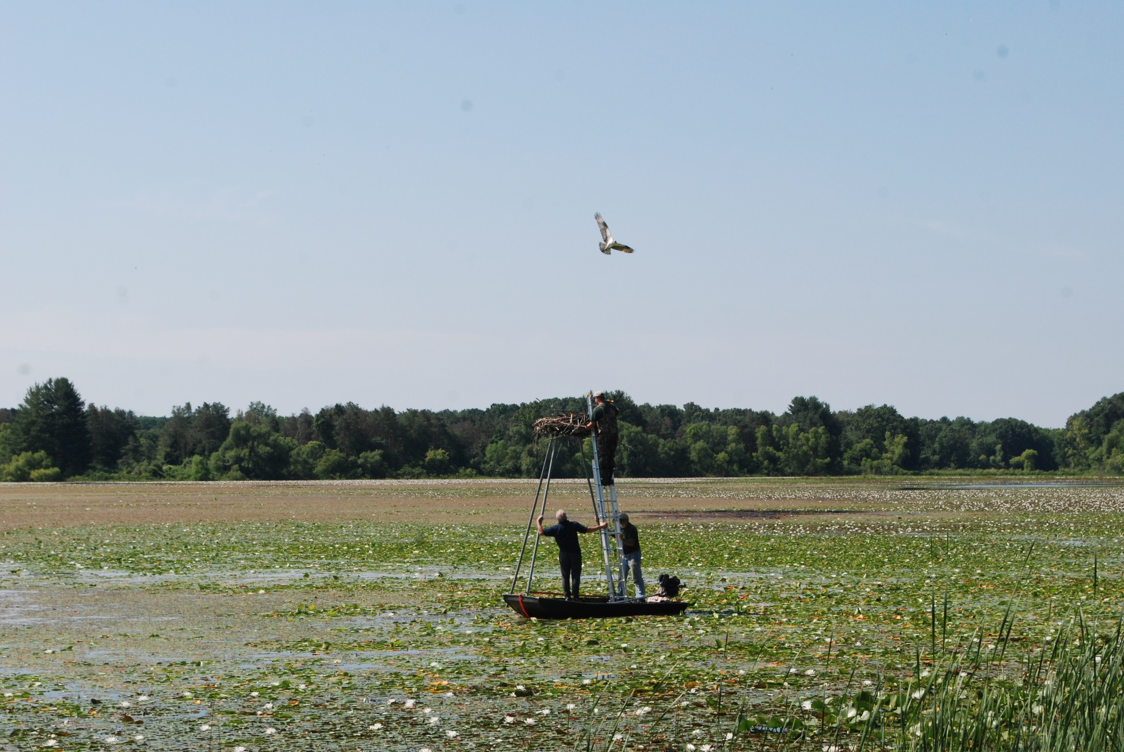
Ken from the Michigan DNR climbs the ladder
two weeks after banding to find the osprey juvenile that
has been chosen to be fitted with a GPS transmitter.
Photo by Sara DePew-Bäby, 2017

Slide 7
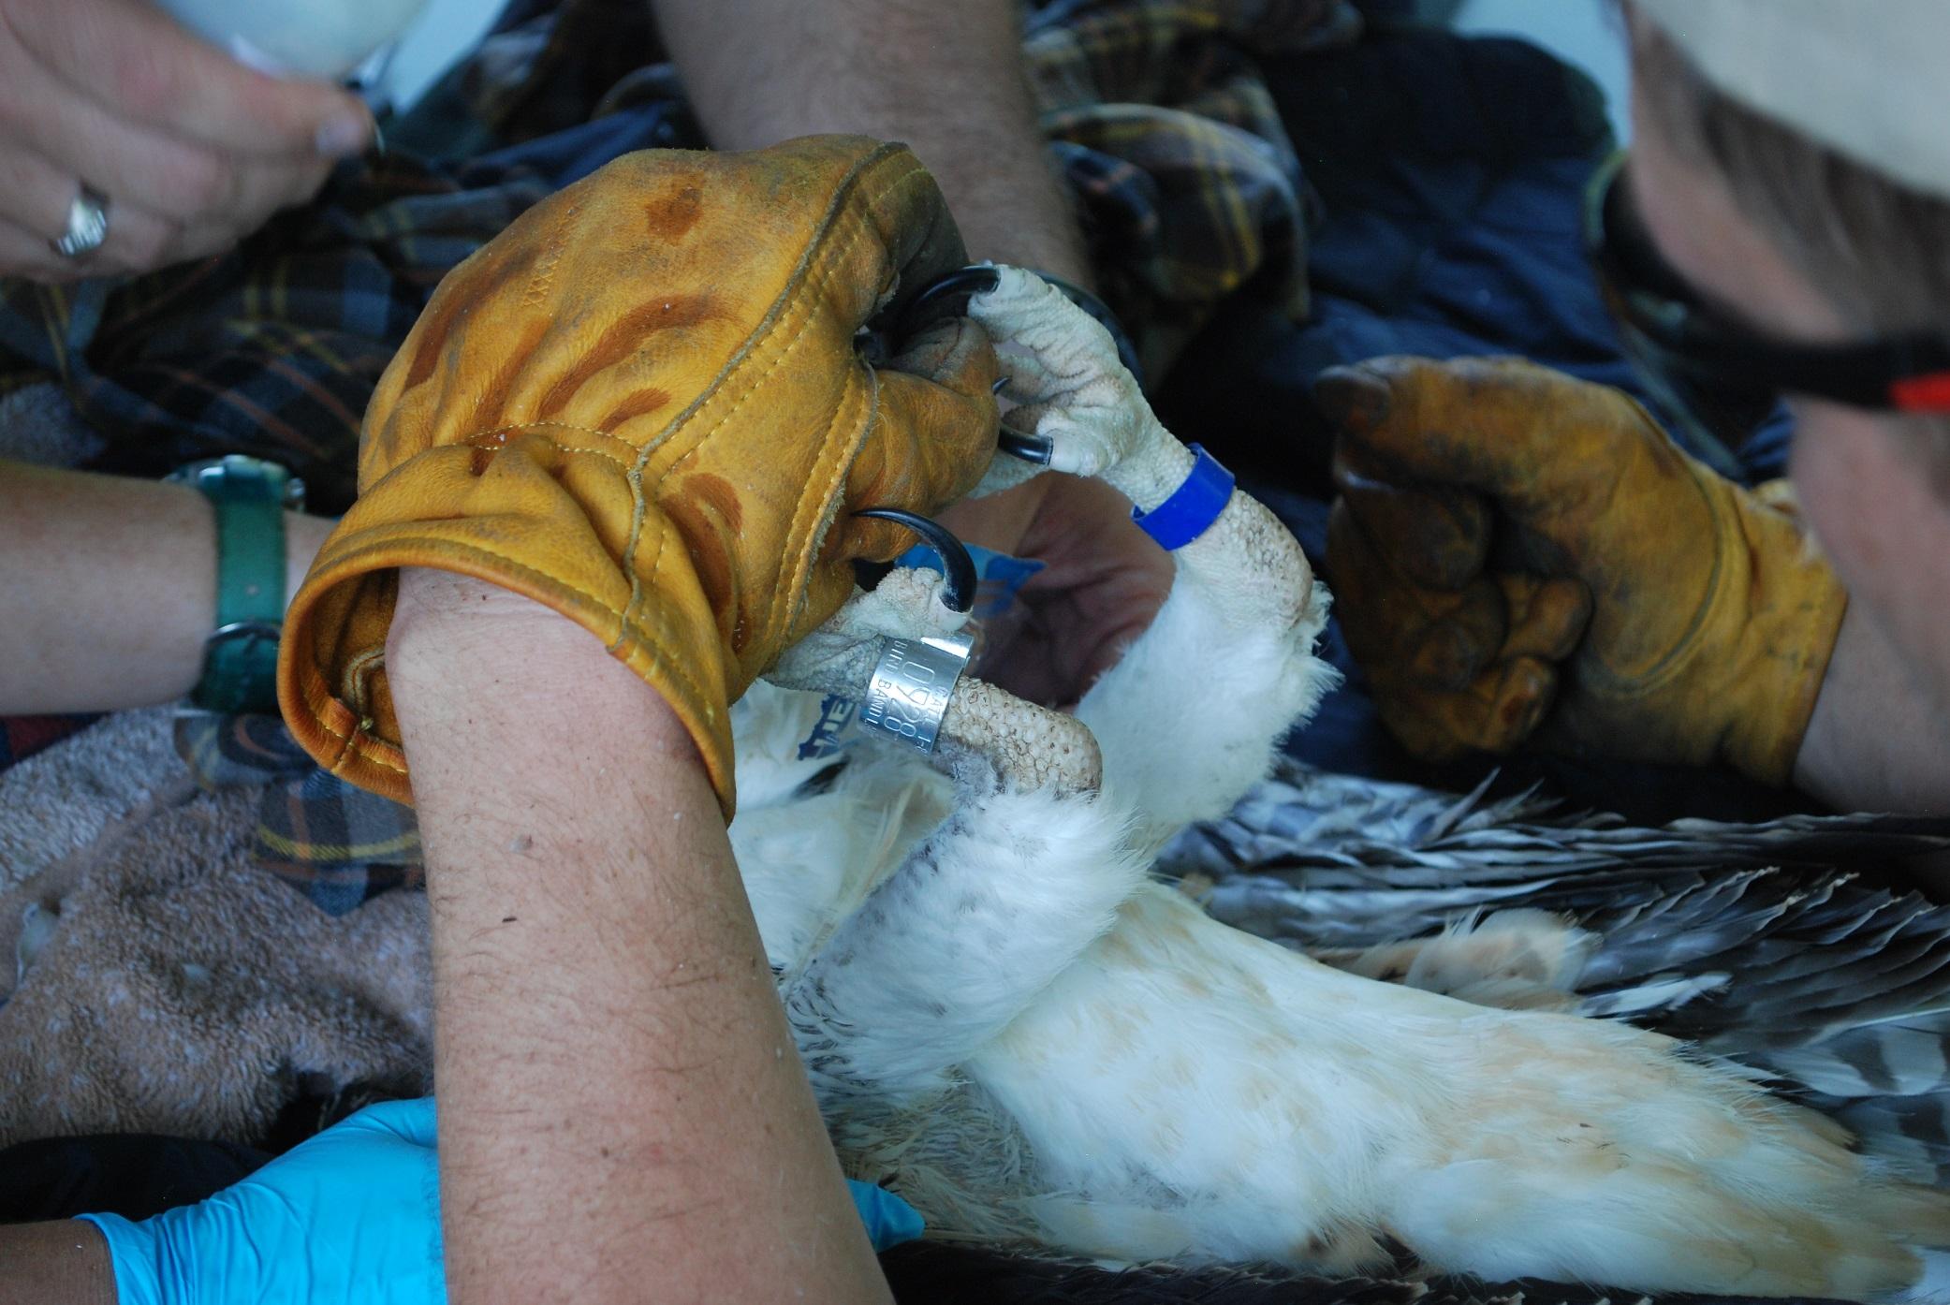
A great look at the bands fitted onto the bird just two weeks earlier.
Photo by Sara DePew-Bäby, 2017

Slide 8
The USDA ties the GPS transmitter “backpack” onto the osprey using leather straps. The GPS never weighs more than 3% of a birds’ body weight.
Photo by Sara DePew-Bäby, 2017

Slide 9
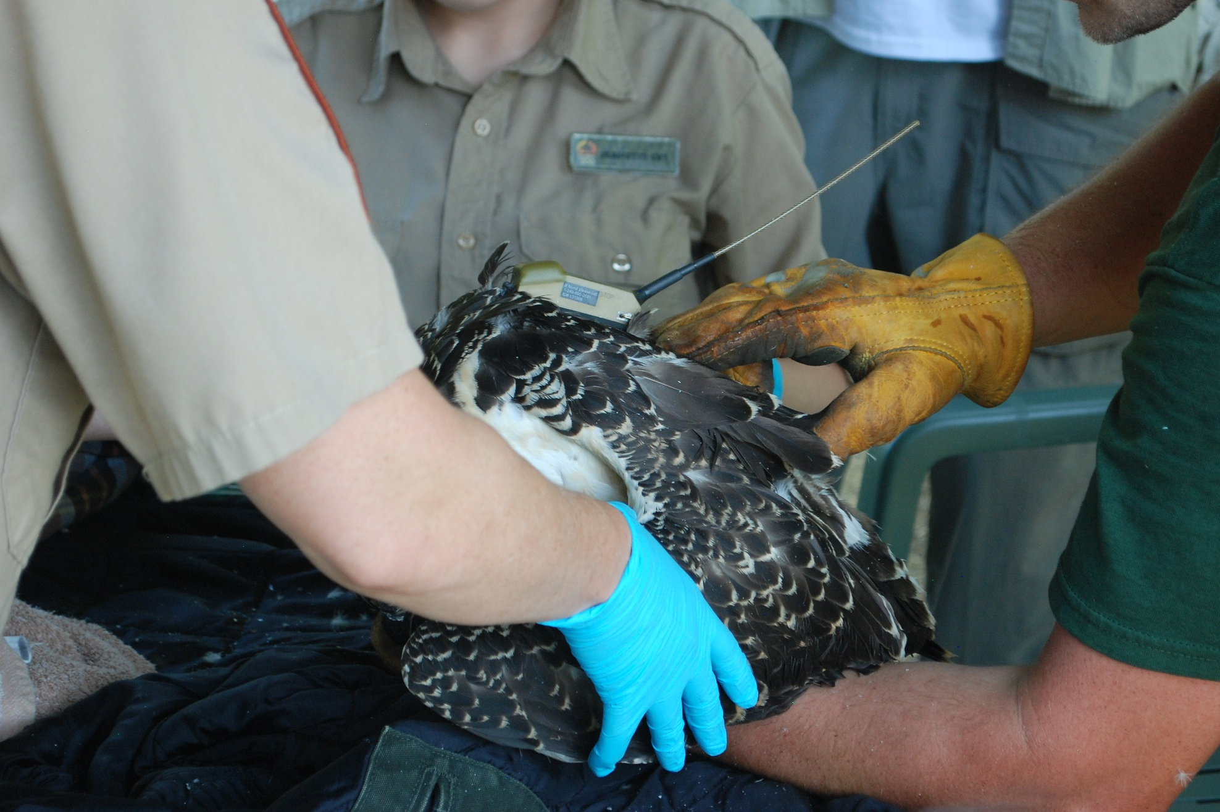
A close up view of the backpack once fitted onto the back of the osprey.
Photo by Sara DePew-Bäby, 2017

Slide 10
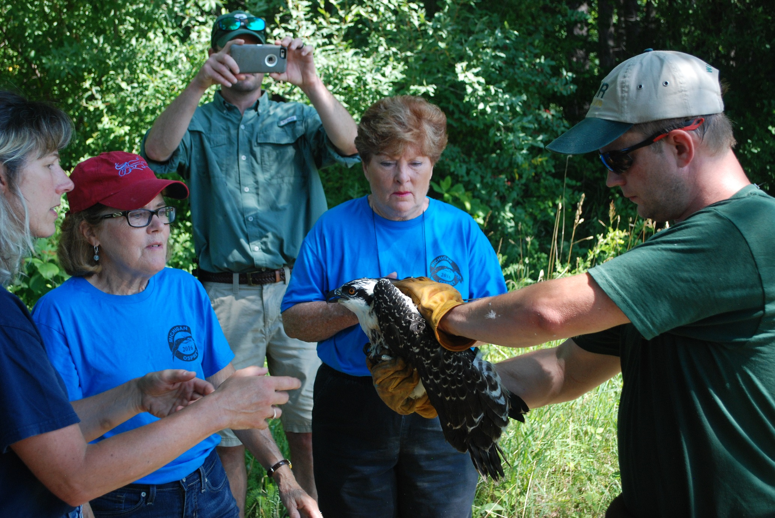
One final check of the osprey before being returned to the nest, by KBS, DNR, and Michigan Osprey staff. The GPS transmitters are purchased by Michigan Osprey, an organization helping to return the birds to the state.
Photo by Sara DePew-Bäby, 2017

Slide 11
GPS transmitter data from August 3, 2017.
http://michiganosprey.org/osprey-migration-tracking/131008-lux-arbor-in-flight/

